Slide 1


Decision Analysis in Research for Agricultural Development
Cory Whitney
Eike Luedeling
cory.whitney@uni-bonn.de

Slide 2
Global sustainability challenges
Economic
Social
How will decisions about agricultural production influence future sustainability?
Ecological

Slide 3

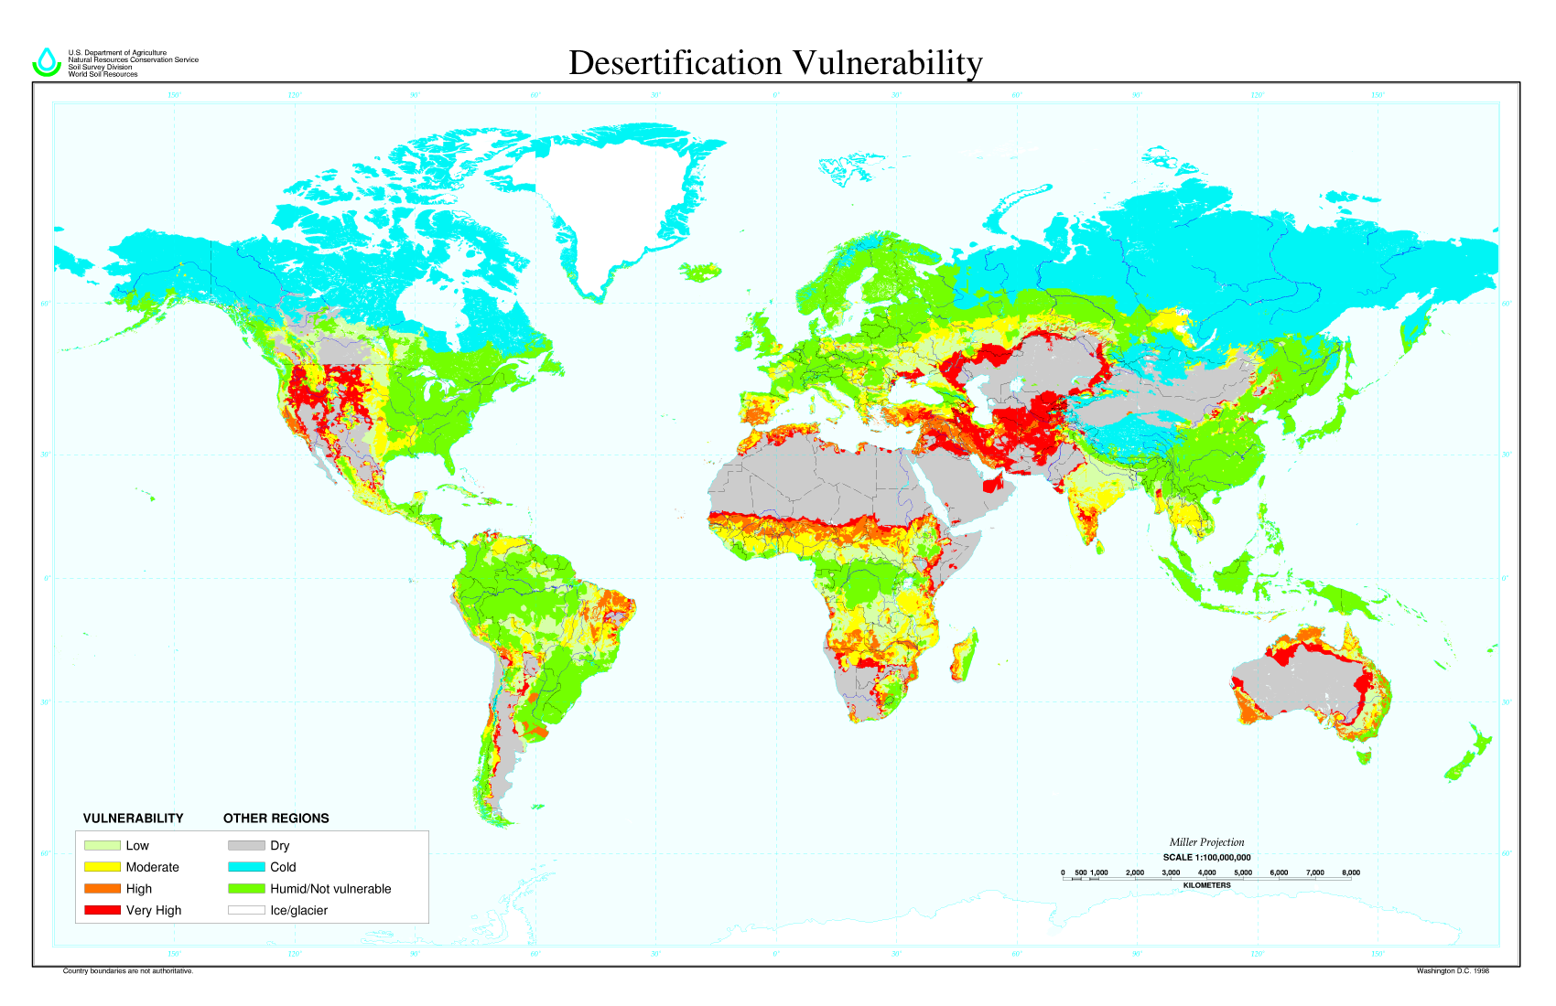

Global sustainability challenges
Desertification vulnerability
Reduced crop yields by up to 50 percent in parts of Africa, Asia, and Central and South America
Intergovernmental Platform for Biodiversity and Ecosystem Services
https://www.luke.fi/wp-content/uploads/2018/03/ipbes-6-l9_en.pdf
US department of Agriculture
Natural Resources Conservation Service
Soil Survey Division
World Soil Resources
Notes:
‘The impact of this population increase on the food system is much more complex than a proportional increase in the demand for food.’ . Nair (2014) describes the many interconnected sustainability social ecological and economic issues in agriculture and ecology and the potential for agroecological approaches to address these issues…

Slide 4

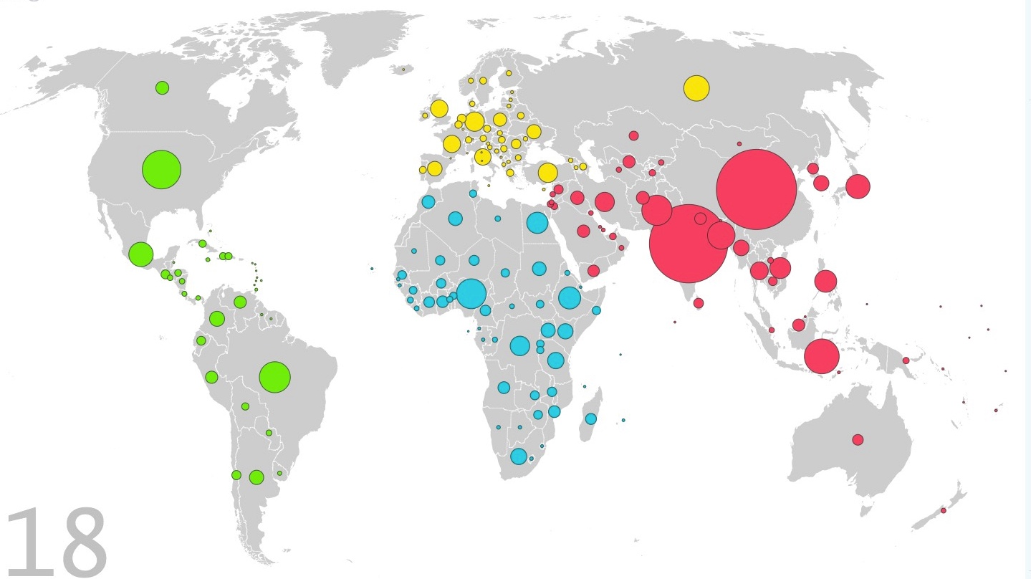
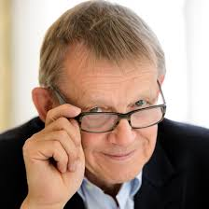

Global sustainability challenges
Global population increase to nearly ten billion by 2050
- United Nations
http://www.un.org/en/development/desa/news/population/2015-report.html
Hans Rosling 1948-2017
Gapminder.com
Notes:
‘The impact of this population increase on the food system is much more complex than a proportional increase in the demand for food.’ . Nair (2014) describes the many interconnected sustainability social ecological and economic issues in agriculture and ecology and the potential for agroecological approaches to address these issues…

Slide 5

Challenges in complex systems analysis
Build balanced causal models of complex systems
Recognize what we already know deal with imperfect information with randomness and multiple perspectives: empirical, expert, local
Make forecasts of system outcomes without perfect information
Identify knowledge gaps
Honestly communicate uncertainties
?
?
?
Agricultural development decision
?
Outputs
?
Outcomes
?
Decision Analysis can meet these challenges
Potential to change the way we do Research for Development
Can overcome challenges in supporting decisions through research

Slide 6
Decision Analysis in Research for Agricultural Development
Approaches
Decision Analysis
Model building
Overcoming Bias
Case Studies
Conclusions

Slide 7
Decision Analysis in Research for Agricultural Development
Approaches
Decision Analysis
Model building
Overcoming Bias
Case Studies
Conclusions

Slide 8
Research for knowledge
Results
KNOWLEDGE
KNOWLEDGE
Before
Does it help with specific decisions?
After
Luedeling et al. 2017, Tropentag Bonn, Cuvillier Verlag, 248.

Slide 9

Transdisciplinary research
“[…] research gaps cannot be identified without talking to farmers and they cannot be addressed without working with farmers.”
Implementation research
Open questions
Millions of unknowns
Limitless research needs
Already known
We know what to do and just need it to be implemented
Biber-Freudenberger et al. 2018. Rural 21, 52(2), 31-33.

Slide 10

Research for impact
Development impact
Not a pure knowledge-generating exercise
Aim:
support development decisions
Improve decisions to generate impact
We can use impact pathways to demonstrate expected decision outcomes
Improved decisions
Support decisions
Agricultural model
Consultative Group on International Agricultural Research
Luedeling et al. 2017, Tropentag Bonn, Cuvillier Verlag, 248.
Notes:
Consultative Group on International Agricultural Research

Slide 11
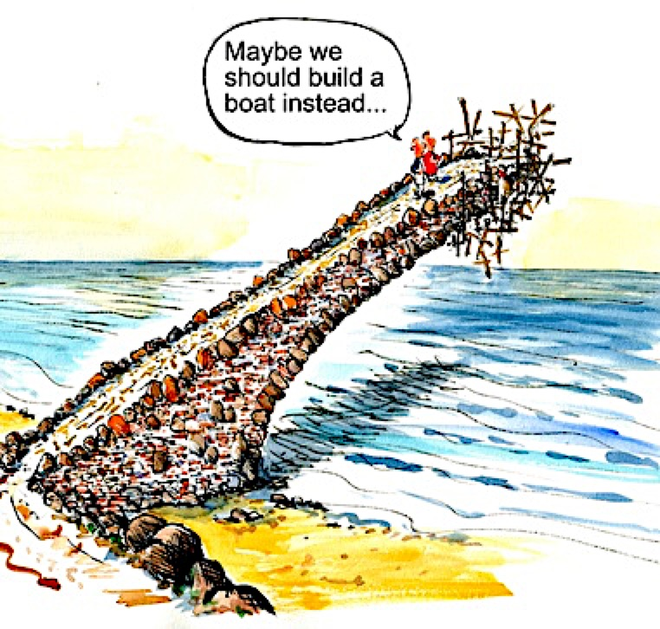
Research for impact
We should plan our work with a view to our impact targets
Do we have an appropriate strategy?
http://www.theoryofchange.org/what-is-theory-of-change/

Slide 12
Impact pathways
Series of events that have to occur for our research to have impact
Research
Outputs
Outcomes
Impacts
Data collection and analysis
Academic papers, reports, presentations, policy briefs
Behavioral change, better decisions are made
Lives and landscapes improve
Luedeling et al. 2017, Tropentag Bonn, Cuvillier Verlag, 248.

Slide 13
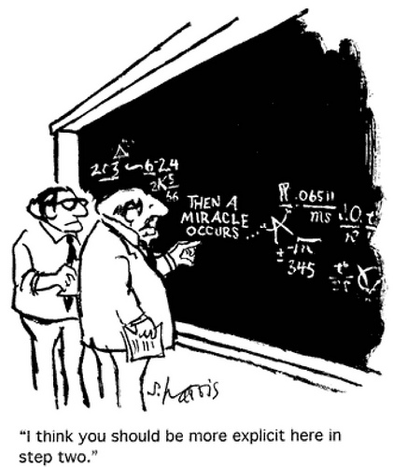
Research for impact
http://www.theoryofchange.org/what-is-theory-of-change/
Impact pathways help ensure that activities are connected to outcomes/impacts in plausible ways
They can expose ‘weak links’ that can be strengthened
Luedeling et al. 2017, Tropentag Bonn, Cuvillier Verlag, 248.

Slide 14
Decisions
Research
Outputs
The weak link
Outcomes
Impacts
Data collection and analysis
Academic papers, reports, presentations, policy briefs
Behavioral change, better decisions are made
Lives and landscapes improve
Somebody actually has to make a better decision because of our work
Is our research addressing decision-relevant questions and delivered through appropriate channels?
Luedeling et al. 2017, Tropentag Bonn, Cuvillier Verlag, 248.

Slide 15
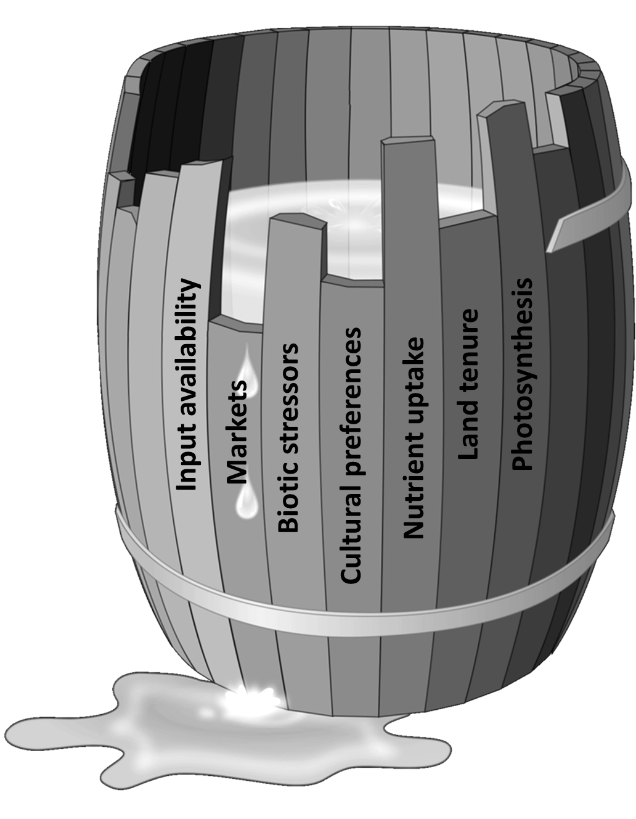
Decisions
Decision-makers must consider biophysical, social, cultural and economic aspects
Balanced inter and transdisciplinary ‘holistic’ perspectives help us connect with real issues
Luedeling E, Shepherd K, 2016. Decision-focused agricultural research. Solutions 7(5), 46-54.

Slide 16
Issues are complex and interdisciplinary
Environmental suprasystem
System behavior arises from a host of factors and interactions
Goals and values subsystem
Technical subsystem
Decision-makers need tools that allow forecasts for the whole system
Managerial subsystem
How can we study the behavior of the whole system?
Informal structural subsystem
Organizational structural subsystem
Can our usual research and modeling approaches address this?
Input-output flow of material, energy, information and influence
Reproduced from: McConnell and Dillon, 1997. Farm Management for Asia: a Systems Approach. FAO Farm Systems Management Series 13 (http://www.fao.org/docrep/w7365e/w7365e00.htm#Contents).

Slide 17
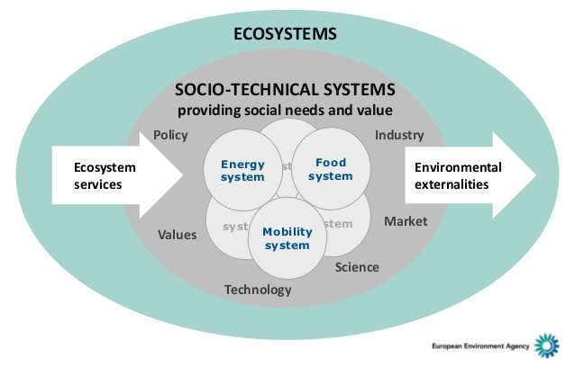
Issues are complex and interdisciplinary
System behavior arises from a host of factors and interactions
Decision-makers need tools that allow forecasts for the whole system
How can we study the behavior of the whole system?
Can our usual research and modeling approaches address this?
Reproduced from: Hans Bruyninckx, European Environment Agency (EEA)
(http://www.fao.org/docrep/w7365e/w7365e00.htm#Contents).

Slide 18
Our usual approach to knowledge generation
Make observations and think of interesting questions
Develop general theories
The scientific method
Formulate hypotheses
Refine, alter, expand or reject hypotheses
Quest for objective, widely valid system behavior rules
Complexity must be reduced to allow hypothesis testing
System is dissected into researchable fragments
Struggles where many disciplines are involved and rules are complex
Gather data to test predictions
Develop testable predictions
Inspired by Luedeling E & https://commons.wikimedia.org/w/index.php?curid=42164616

Slide 19
System models from solid building blocks?
Can we ‘stack’ study results obtained with the scientific method to gain system understanding?
Or if we can’t get enough blocks
Sufficient knowledge for decision support
Study 3
Doesn’t work if the blocks don’t fit
Study 2
Study 3
Study 1
Study 1
Study 2
Luedeling et al. 2017, Tropentag Bonn, Cuvillier Verlag, 248.

Slide 20
System models from solid building blocks?
Large remaining knowledge gap
100%
Stochastic (random) effects (e.g. biotic stresses, price fluctuations)
Fundamental uncertainties (future climate, conflicts)
Possible thresholds for decision-relevance
Ability to predict system outcomes
Research effort, Number of disciplines, Funding needs
Luedeling et al. 2017, Tropentag Bonn, Cuvillier Verlag, 248.

Slide 21
Comparing options with incomplete models
Increasing comprehensiveness doesn’t change recommendation
Two (related) problems
Failure to grasp the full complexity of agricultural operations
Inadequate consideration of errors and uncertainties
Monocrop system
Predicted relative performance
Complex agroforestry system
Completeness of understanding
Recommendation changes
incomplete research produces the wrong recommendation
If we were honestly estimating the resulting errors…
Micronutrients produced
Additional farm products
Regulating ecosystem serv.
Energy produced
Direct household income
Off-farm impacts
Staple crop yield
Impact on GDP
Luedeling et al. 2017, Tropentag Bonn, Cuvillier Verlag, 248.

Slide 22
Comparing options with incomplete models
Very large confidence intervals for incomplete studies
Error bars only short for reasonably comprehensive assessments
We avoid valuing at ‘zero’ all elements we haven’t included
Monocrop system
Predicted relative performance
Complex agroforestry system
Completeness of understanding
Micronutrients produced
Additional farm products
Regulating ecosystem serv.
Energy produced
Direct household income
Off-farm impacts
Staple crop yield
Impact on GDP
Luedeling et al. 2017, Tropentag Bonn, Cuvillier Verlag, 248.

Slide 23
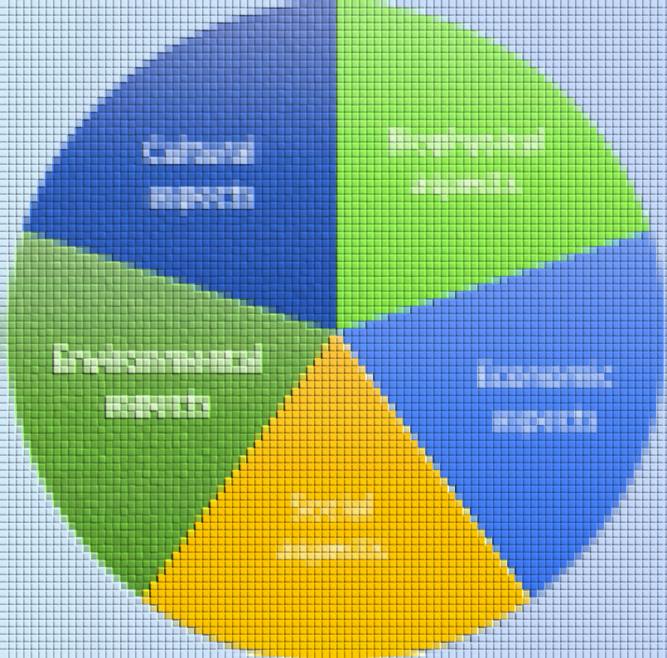
How to do a small study on agriculture
Cultural aspects
Biophysical aspects
Cultural aspects
Biophysical aspects
Environmental aspects
Economic aspects
Biophysical aspects
Environmental aspects
Economic aspects
Social aspects
Social aspects
By addressing one aspect in great detail?
An agricultural system
Or by doing a coarser assessment that includes all essential dimensions?
Are our results still relevant for the agricultural system?
Given limited resources for research, how should we study this?
Usually preferable, but how can it be done?
Luedeling et al. 2017, Tropentag Bonn, Cuvillier Verlag, 248.

Slide 24
Decision Analysis in Research for Agricultural Development
Approaches
Decision Analysis
Model building
Overcoming Bias
Case Studies
Conclusions

Slide 25
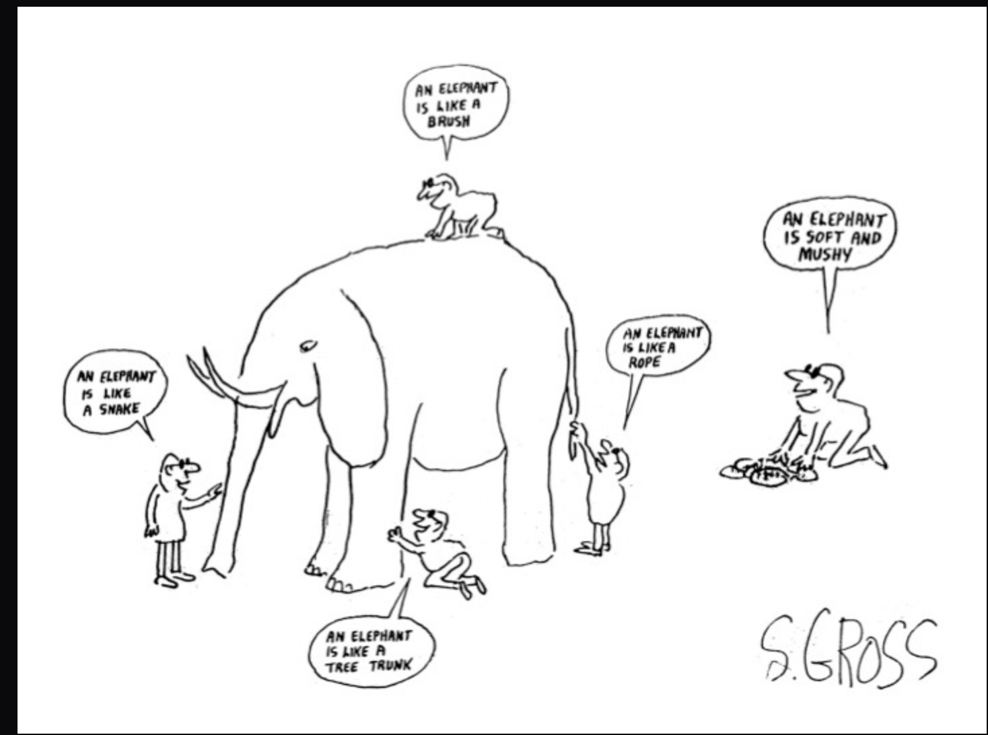
Holistic model building for decision support
"Every specialist [..] believes that he understands the entire human being, while in reality he only grasps a tiny part […]”
Dr. Alexis Carrel
Nobel laureate
Decision Analysis
Modeling
Principles
Implications
Processes
Example
Resources
Gross, S., 1980. Dodd Mead, New York
Notes:
Introduction / recap of the principles of decision analysis and why we think the mindset is applicable in this case

Slide 26
Decision Analysis
Discipline comprising the philosophy, theory, methodology, and professional practice necessary to address important decisions in a formal manner.
https://en.wikipedia.org/wiki/Decision_analysis
- What is the rational course of action based on our knowledge?
- What priority measurements could help us make better decisions?
Shepherd et al., 2015. Nature 523, 152-154.
Incorporate uncertainty
using stochastic modeling tools
Notes:
From Bayes about the probability of an event given evidence is largely influenced by the prior probability of the event and the evidence

Slide 27
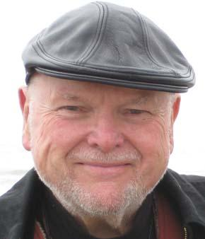
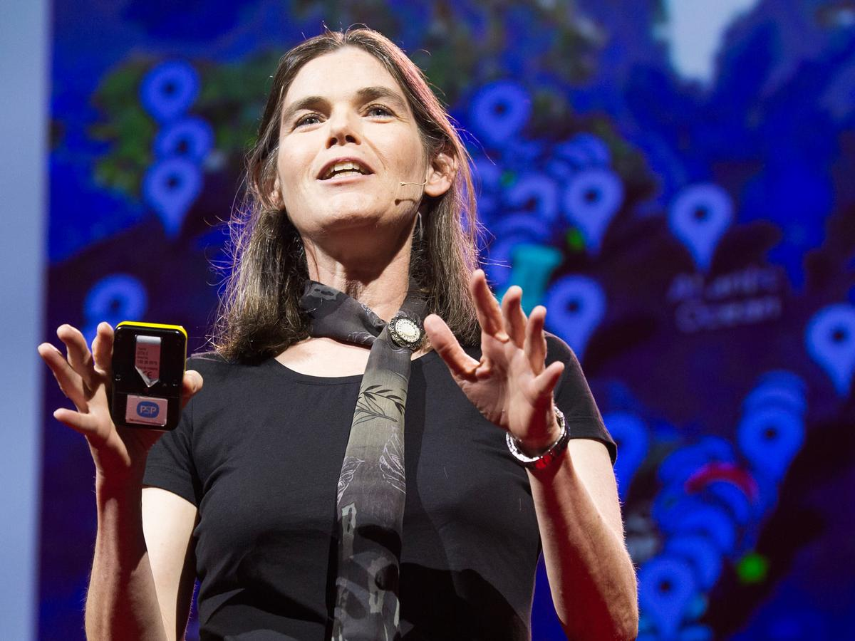
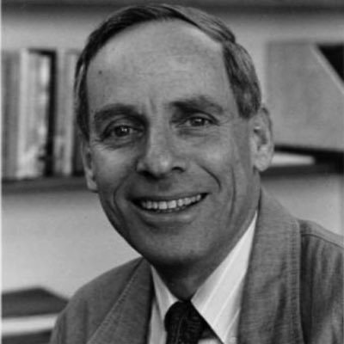

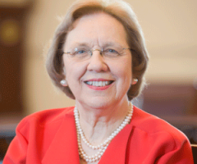
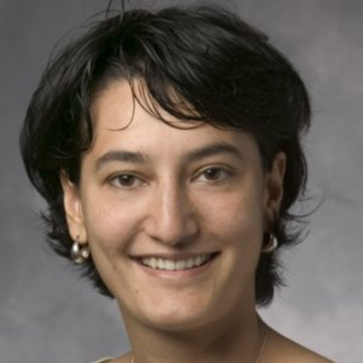
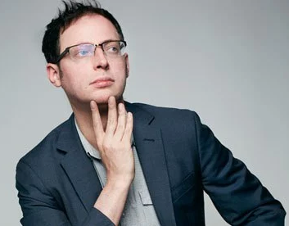
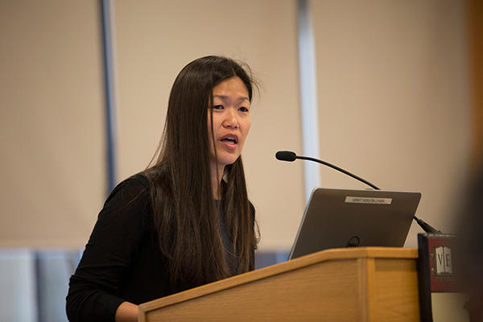


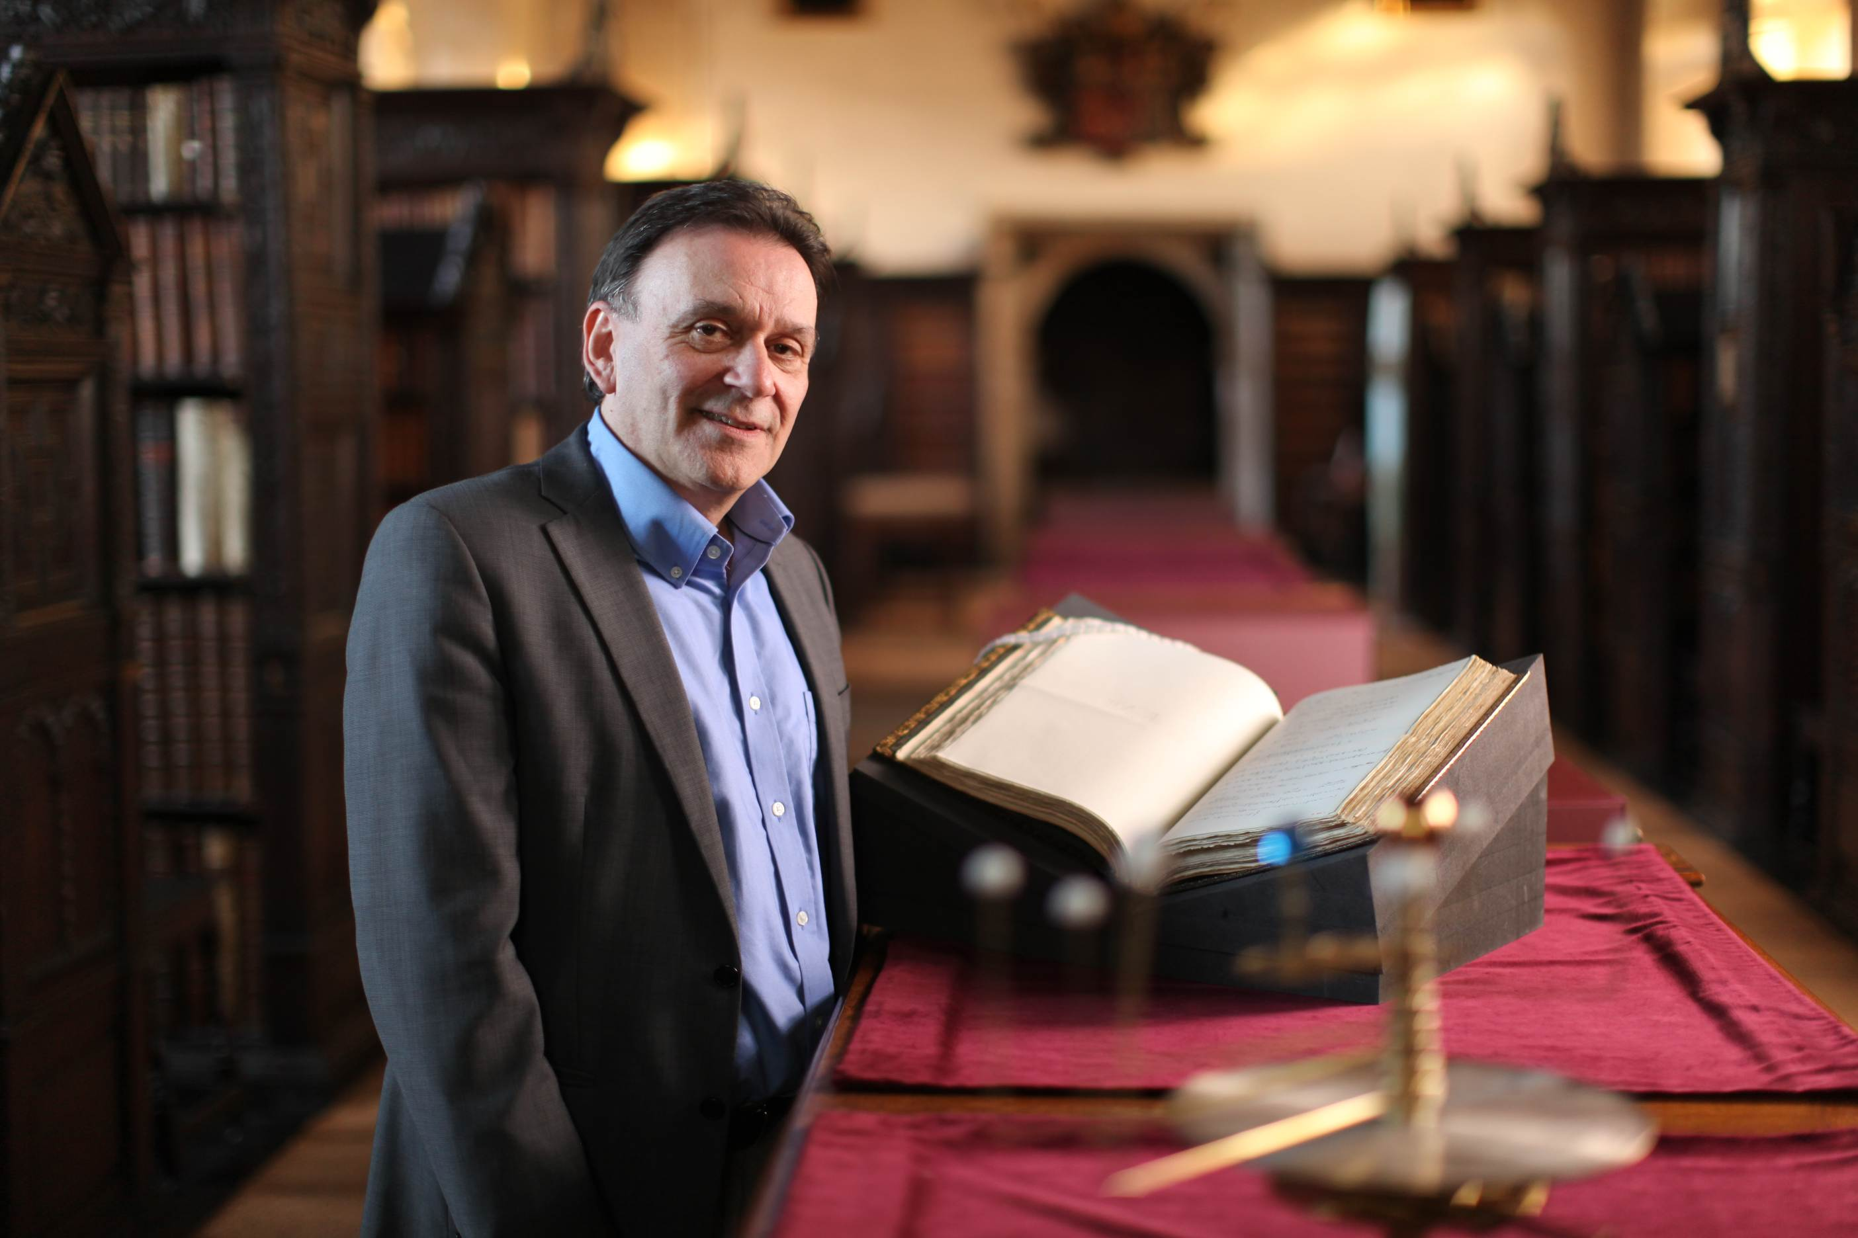
Great minds of Decision Analysis
Daphne Koller
Stanford University
Amos Tversky
1937-1996
Daniel Kahneman
Nobel Prize 2002
Barbara Niel
Harvard Medical School
Ron Howard
Stanford University
Daniela Ladner
Northwestern Medicine
Nate Silver
FiveThirtyEight
Jane Kim
Harvard School of Public Health
Karen Jenni
U.S. Geological Survey
Douglas Hubbard
H. Decision Research
Norman Fenton
Queen Mary University
Notes:
Not reinventing the wheel. This is a well established field. For some reason not much applied in horticulture and agriculture

Slide 28
How decision-makers generate knowledge
good
Recommend preferable option
Structured decision analysis
Identify key uncertainties
For systems too complex to fully understand (with available resources)
For supporting decisions that must be made without perfect information
“What’s the best option according to our limited understanding?”
Measure where information value is high
Quantitatively project decision outcomes
Characterize all risks and uncertainties
Model the situation using all available information
Frame entire decision context
Luedeling et al. 2017, Tropentag Bonn, Cuvillier Verlag, 248.

Slide 29
Probabilistic simulation
Deterministic
model
Probabilistic
model
1.456
20
5
3
100
Allows working with variables that we don’t have perfect knowledge on
Requires characterizing our uncertainty about them
Common methods are Monte Carlo simulation and Bayesian Network
Distributions as input, because precise values are unknown
Precise numbers as input
Precise number as output
42
Distribution as output
Luedeling et al. 2017, Tropentag Bonn, Cuvillier Verlag, 248.

Slide 30
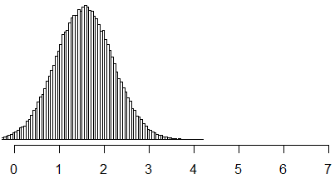
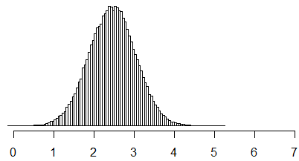
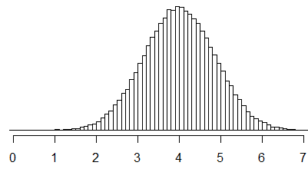
Monte Carlo simulation
Monte Carlo simulation with 100,000 runs
Mont
Can we work with what we actually know rather than with allegedly precise numbers we aren’t really sure about?
How much is a+b, if a=1 and b=3?
How much is a+b, if we assume normality &:
are 90% certain 0.5< a <1.5
and 2.6< b <3.4
Monte Carlo draws many random samples from these distributions for a distribution that expresses our uncertainty about a+b
a
b
a+b
Luedeling et al. 2017, Tropentag Bonn, Cuvillier Verlag, 248.

Slide 31
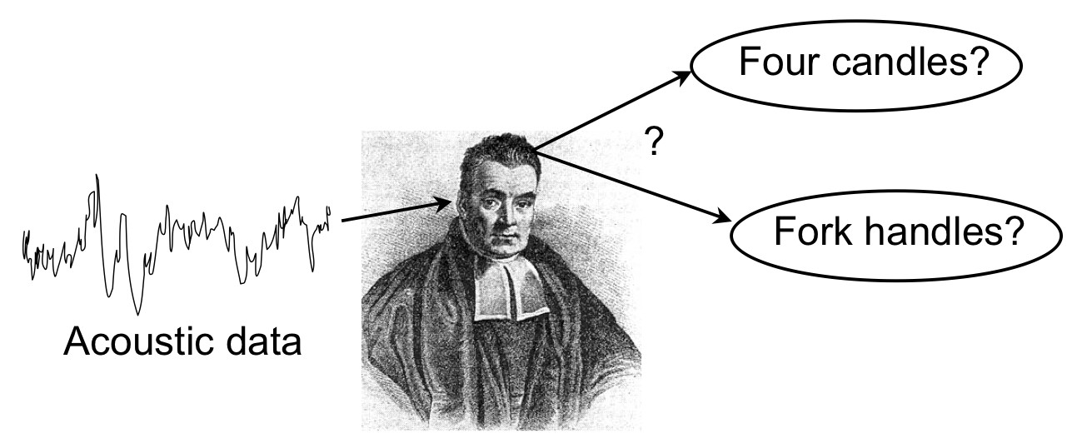

Probability that ‘B’ is true given ‘A’ is true
Bayes Theorem
All possibilities
Probability that ‘A’ is true
B
P(B|A) P(A)
P(A|B) =
A
P(B)
Probability that ‘B’ is true
Probability that ‘A’ is true given ‘B’ is true
A|B
theatlantic.com
Thomas Bayes
(c. 1701-1761)
http://www.polfed.org/
Notes:
The formula as a whole is built using basic algebra. It might look complicated but it is actually quite user-friendly. Every time you use the formula all you need to do is remember the three ingredients, find them, plug them into the formula, and voila. You will then have an updated probability based on new information; you’ll have P(A|B), which is technically called the Posterior Probability and is a normalized weighted average.

Slide 32
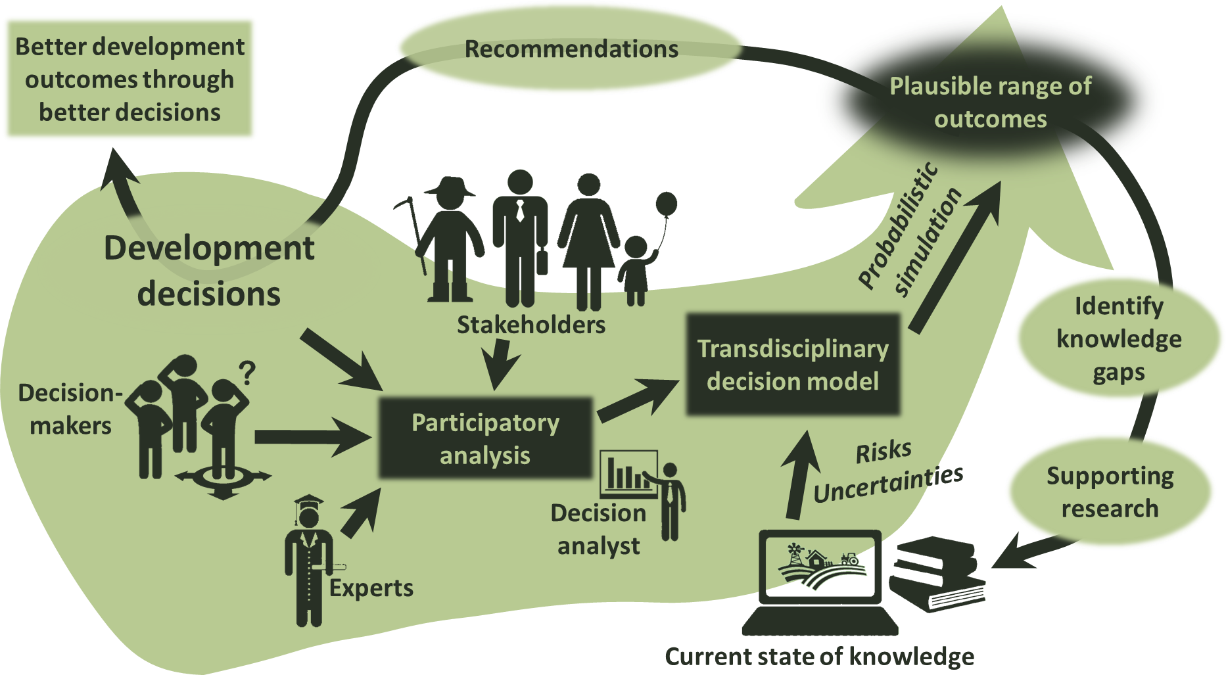

Decision Analysis
Luedeling and Shepherd, 2016. Solutions 7(5), 46-54.

Slide 33
Decision Analysis
Science with fuzzy information
Figuring out how systems work
Estimating our state of knowledge
Value of information
Analysis strategy capable of addressing decision problems
Luedeling et al. 2017, Tropentag Bonn, Cuvillier Verlag, 248.

Slide 34
Decision Analysis in Research for Agricultural Development
Approaches
Decision Analysis
Model building
Overcoming Bias
Case Studies
Conclusions

Slide 35

Modeling principles
Incorporate all important aspects into models
Model system using all sources of information, including local and expert knowledge
Explicitly consider uncertainties about inputs, processes and outputs
Identify key uncertainties for measurement using ‘Value of Information’ analysis
Update and clarify model, when new information becomes available
A?
A
a1
a1
a2
?
a4
a2
a4
?
b3
b3
?
b2
?
b2
a3
a3
?
b4
b4
b1
b1
Luedeling & Shepherd, 2016. Solutions 7(5), 46-54.
Notes:
examine alternatives in an explicit and logical way - valued on a single coherent scale that may vary - sensitivity analyses for changes that can influence decisions

Slide 36
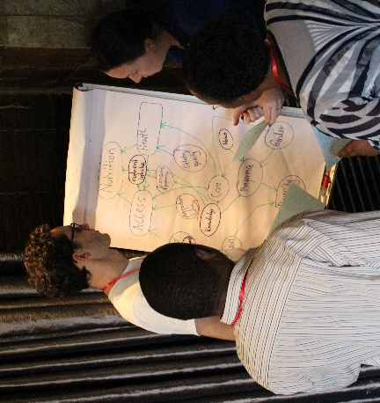
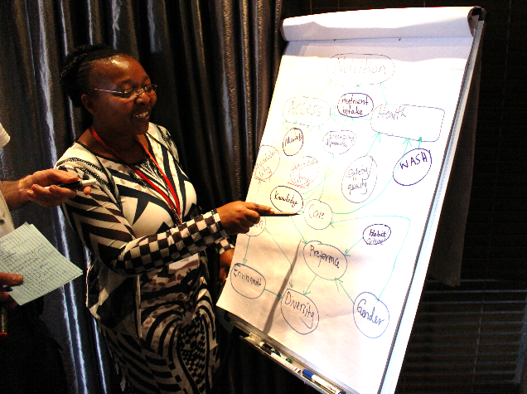
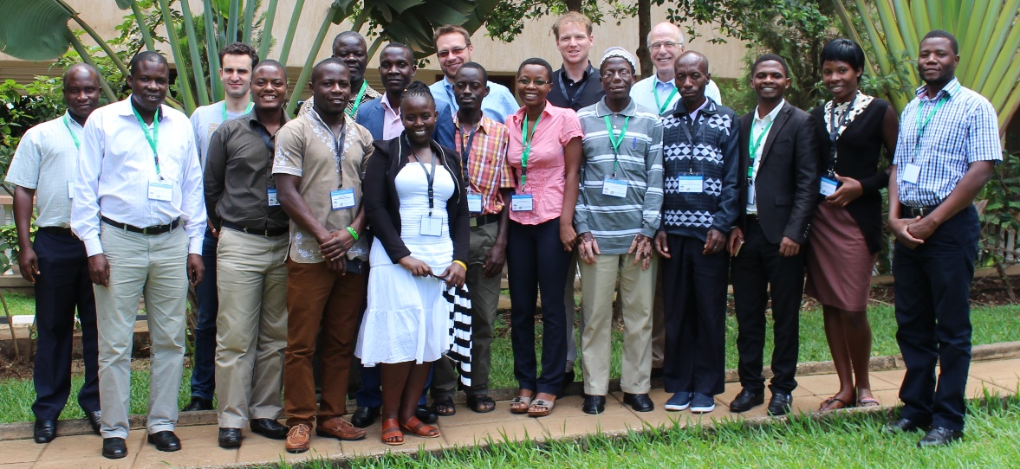
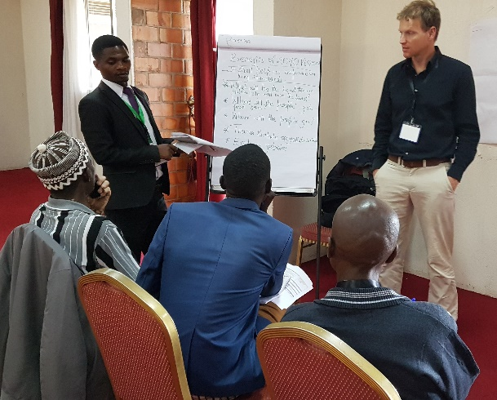
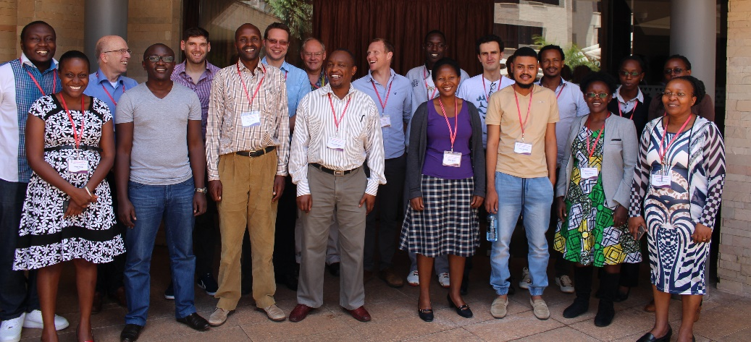
Model development process
Convene experts, stakeholders and decision-makers to jointly develop a causal decision model
Gather subject-matter knowledge, as well as context- and decision-specific information

Slide 37
Model development process
Experts
Frame
Analyze
Model
Analysts
Notes:
Development problems: Lack of concrete data, many sources of info, wealth of expert in-depth knowledge

Slide 38
Model development process
Specific problem defined
Divergence
Convergence
Emergence
Program model
Identify important variables
Follow up and share
Collect all ideas
Clarify relationships and concepts
Open discussion
Focused discussion
Gather diverse variables / interactions
Develop concrete descriptions (circles and arrows)
Unpack / disaggregate complexity
Peer review of graphical model

Slide 39
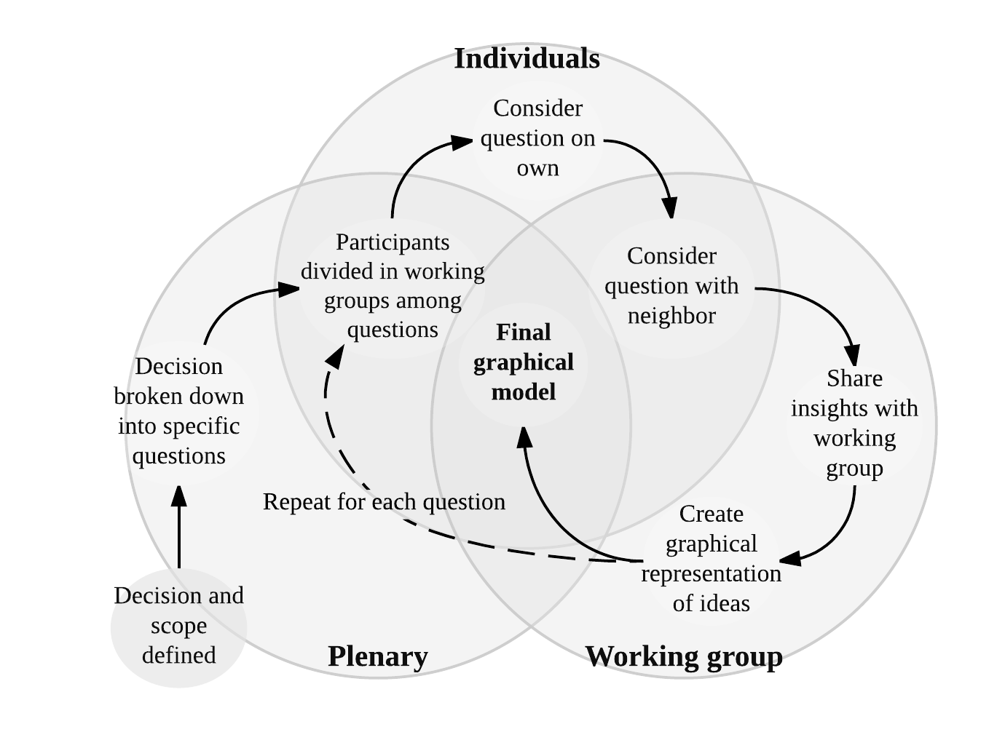
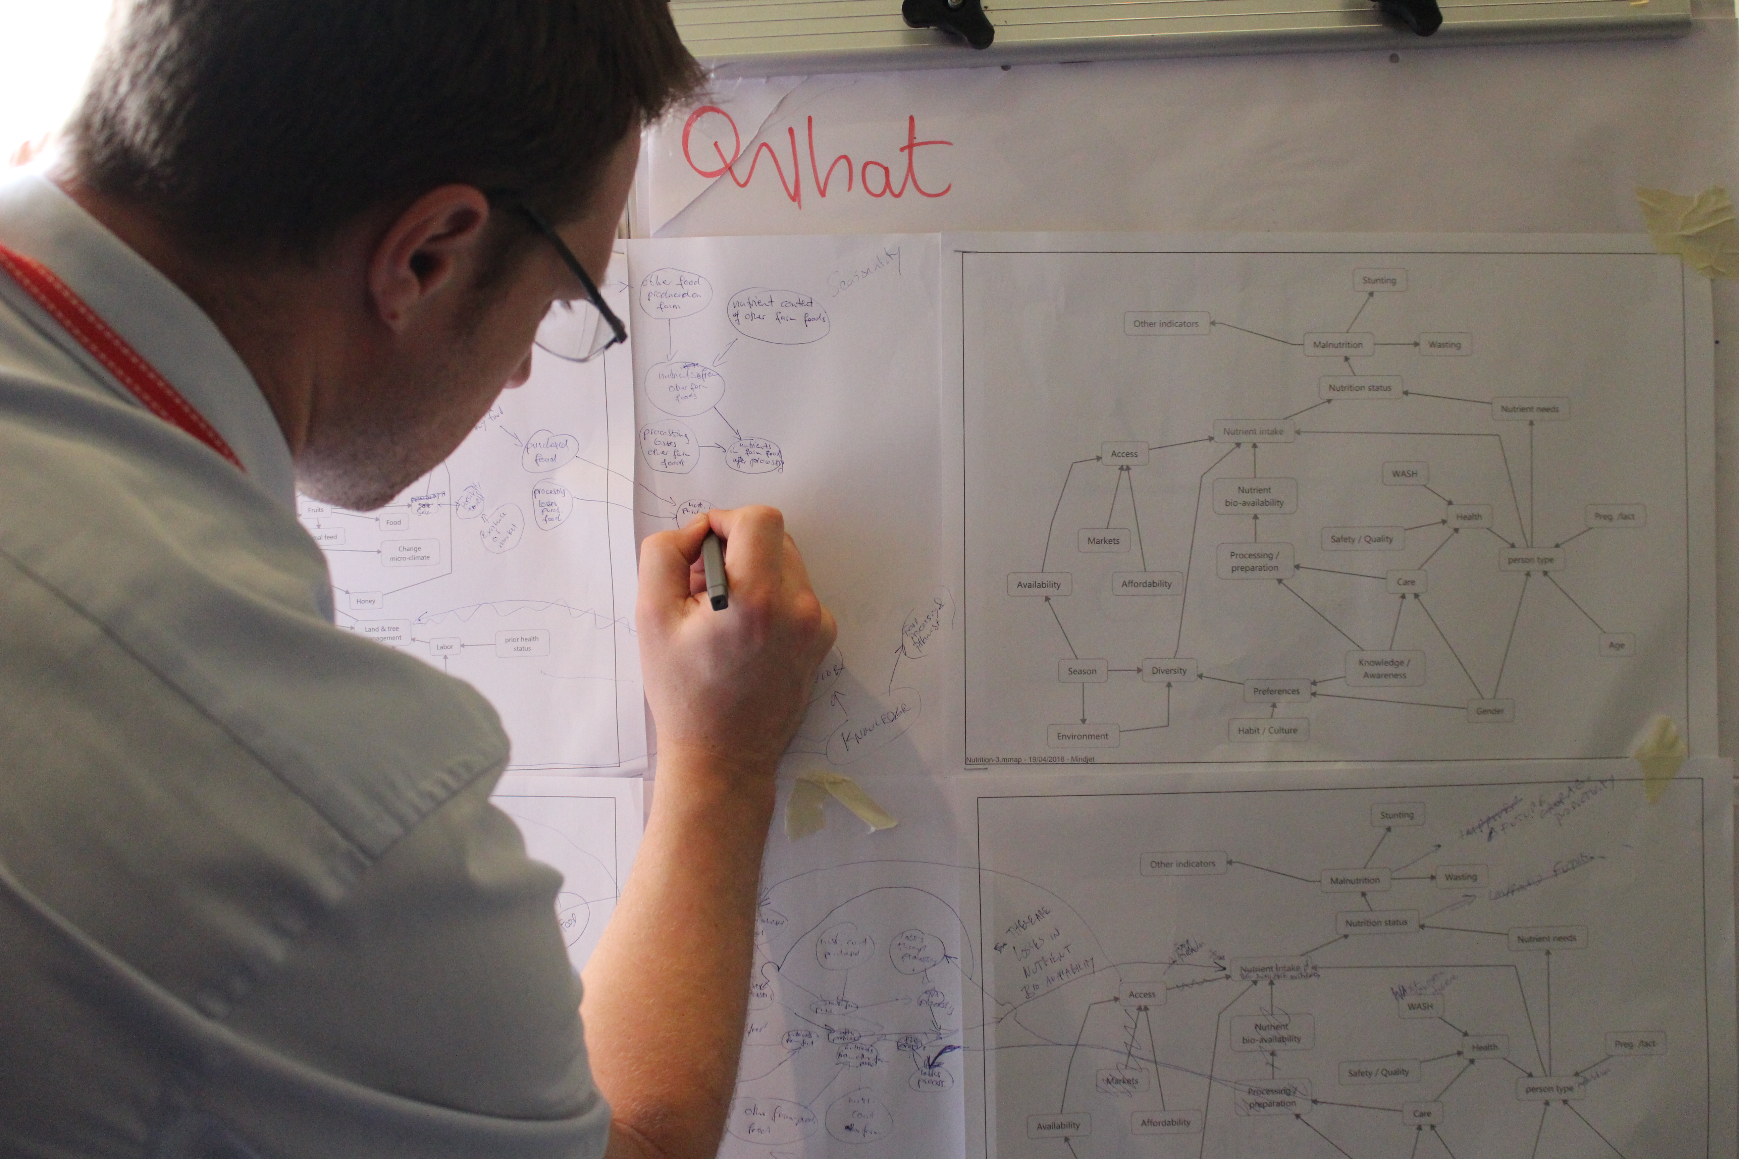
Model development process
Qualitative model
Eike Luedeling helping make connections Fruit trees and nutrition in Kenya
Whitney, C., Shepherd, K., and Luedeling, E., 2018.
World Agroforestry Centre, Nairobi.

Slide 40
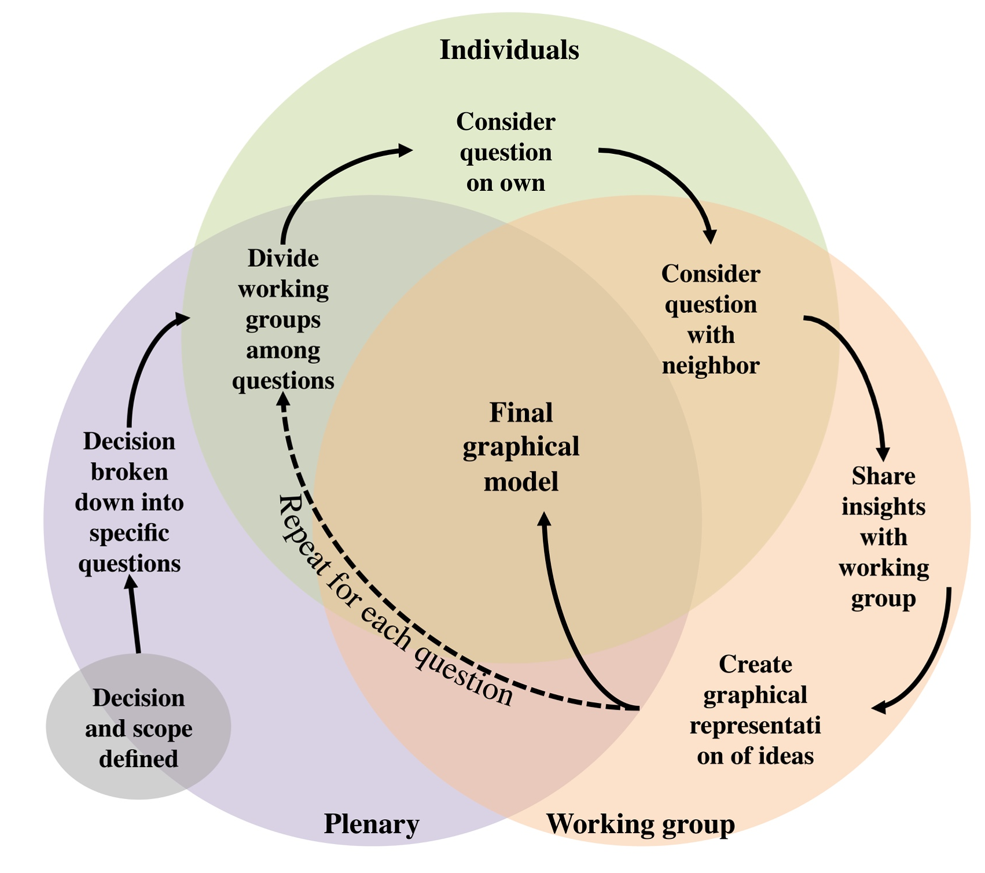

Model development process
Whitney et al. 2018. Earth’s Future, 6(3), 359-372.

Slide 41
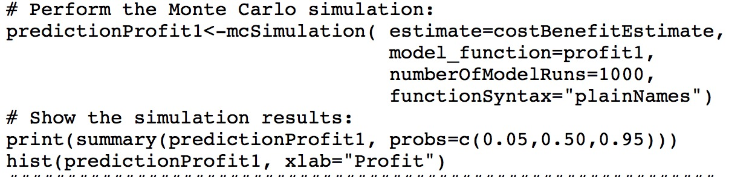
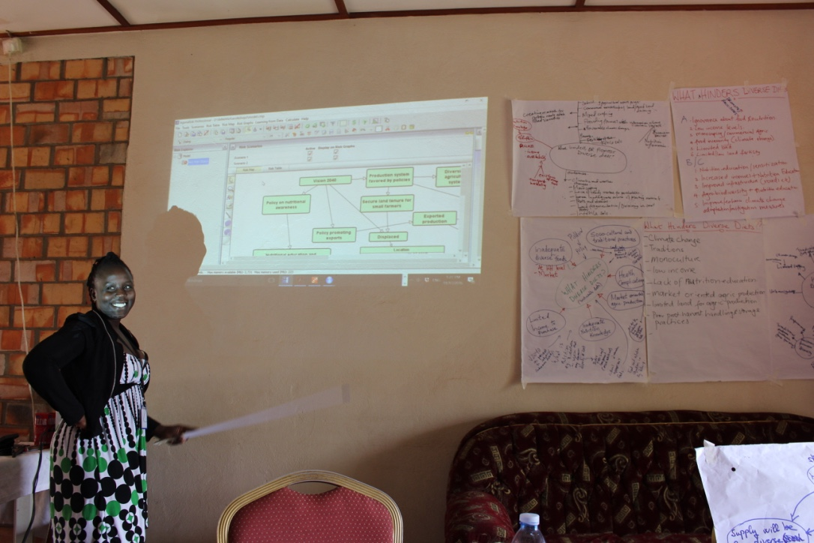

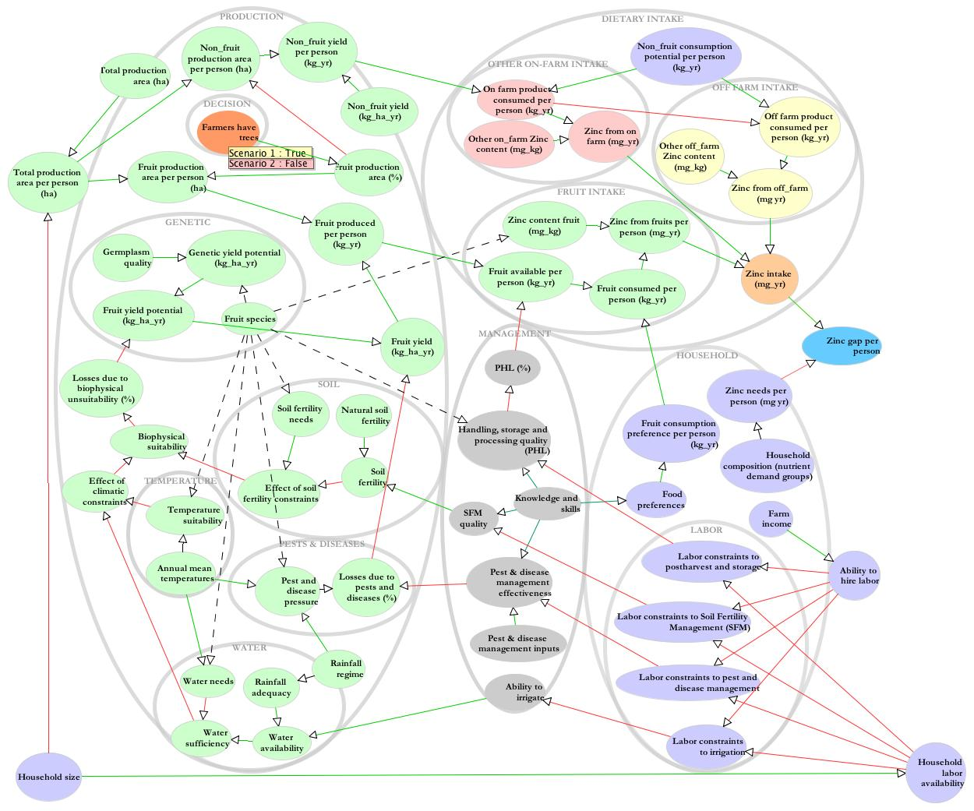

Model development process
Model programming
R: The R Project for Statistical Computing
https://www.r-project.org/
AgenaRisk
https://www.agenarisk.com/
Carolyne Nakaketo helps with model programming in Uganda.
Whitney, C., Shepherd, K., and Luedeling, E., 2018.
World Agroforestry Centre, Nairobi.

Slide 42
Decision Analysis in Research for Agricultural Development
Approaches
Decision Analysis
Model building
Overcoming Bias
Case Studies
Conclusions

Slide 43


Cognitive biases
www.mainlesson.com
https://www.tlnt.com
Model developers
Biases can be a bottleneck in the model development process

Slide 44
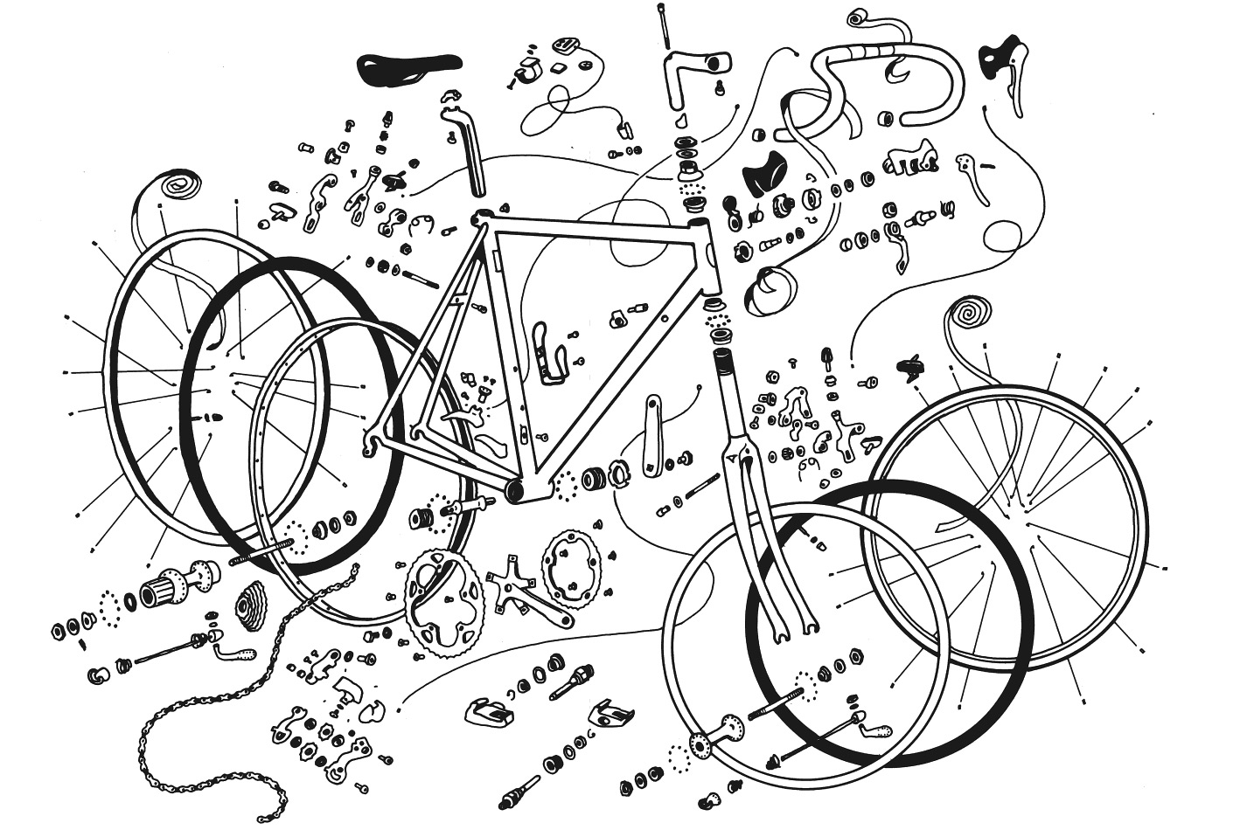
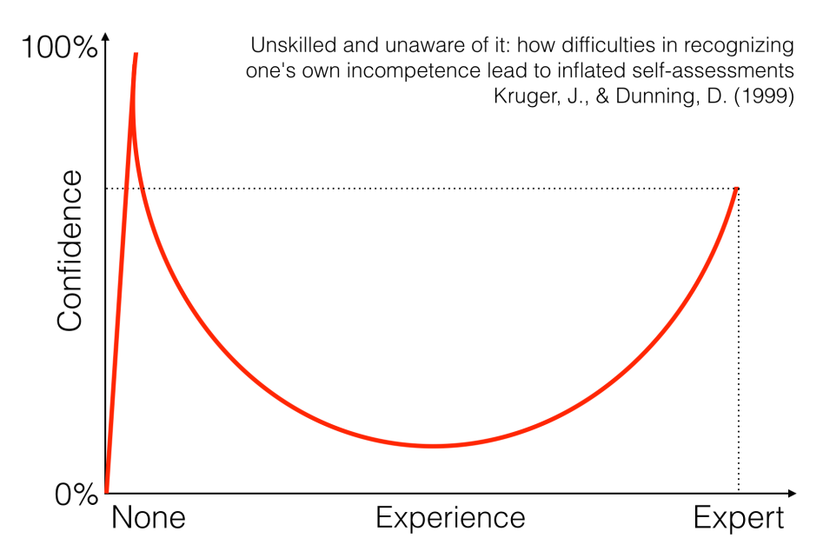
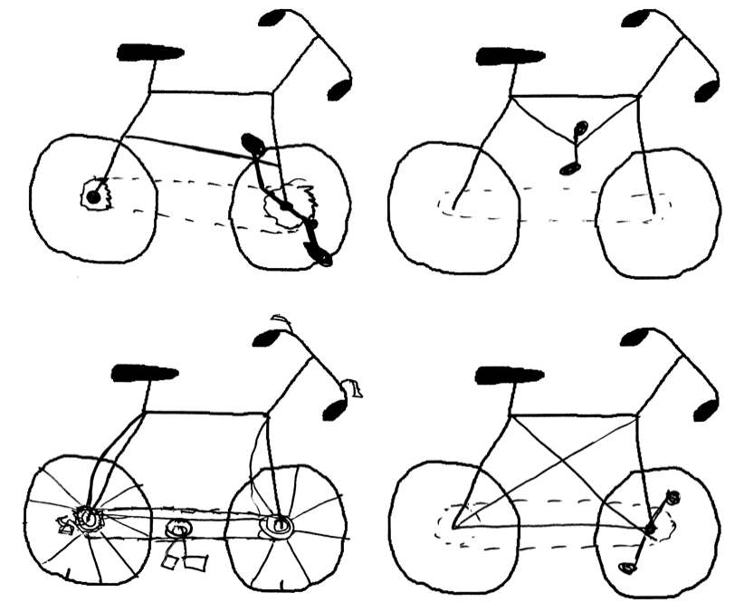
Cognitive biases
Dunning-Kruger effect
Lawson. 2006. Memory and Cognition. 34(8)
Zinn 2016. Zinn & the Art of Road Bike Maintenance, 5th Ed. Velo Press
http://story.fund/post/114093854037/dunning-kruger-effect
Notes:
>800 parts and complex balance ergonomic in structure, experts will be cognizant what they don’t know

Slide 45


Anchoring
Cognitive biases
Daniel Kahneman
Study with a rigged wheel of fortune that only had 2 numbers (10 and 65)
Test persons were asked to spin the wheel and write down the number
Then they were asked the question ‘What is the percentage of African nations in the UN?’
Average for those that landed on 10: 25%
Average for those that landed on 65: 45%
http://www.voilamart.com/editable-24-color-prize-wheel-of-fortune-trade-show-tabletop-spin-carnival-game
Kahnemann, 2011. Thinking, Fast and Slow. Penguin.

Slide 46
Cognitive biases
Confirmation bias
Interpret things so that they confirm prior belief
What the facts say
What confirms
prior belief
Undervalued
Overvalued
Foolish

Slide 47
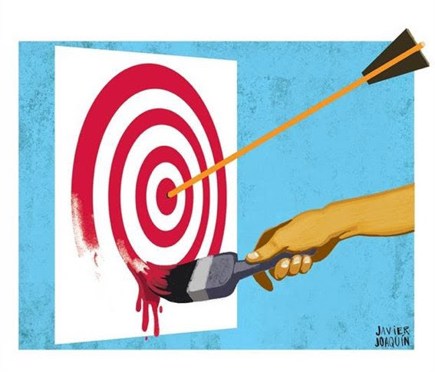
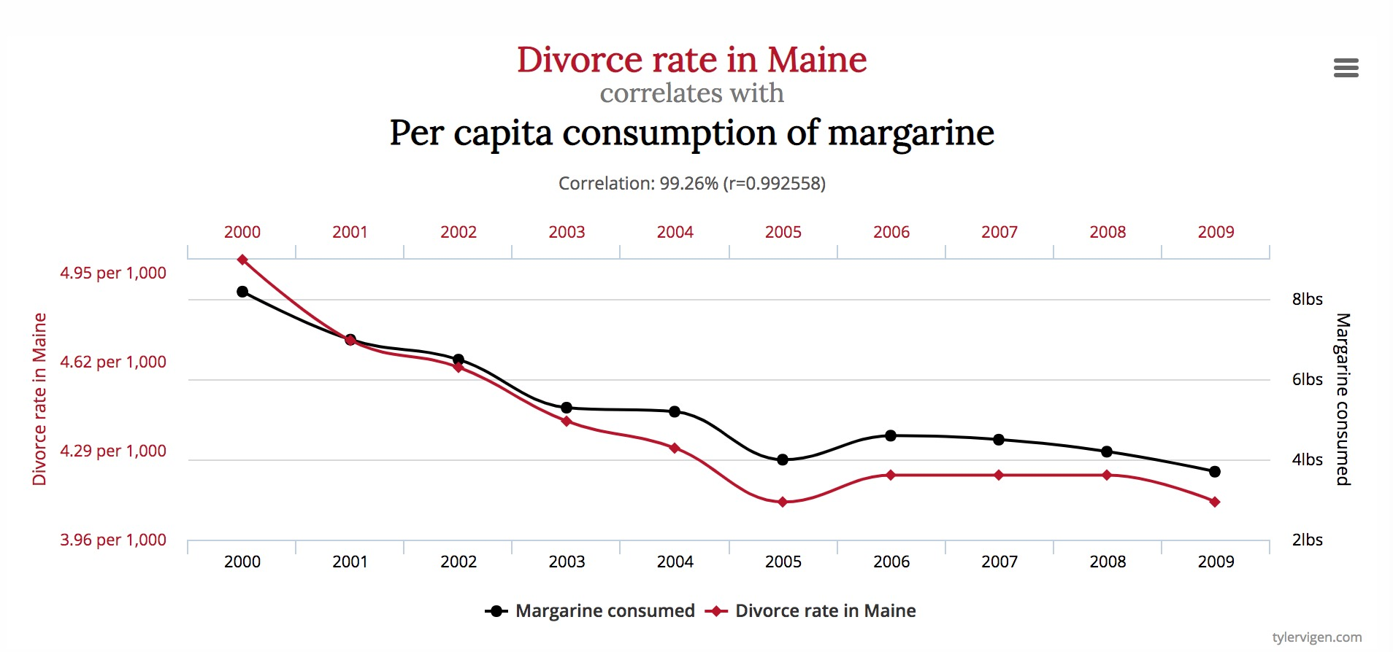

Cognitive biases
Confirmation bias
tylervigen.com

Slide 48
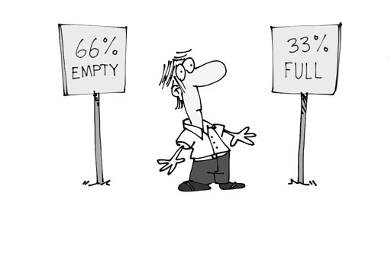
Framing effect
Cognitive biases
Drawing different conclusions from the same information, depending on how that information is presented
.5
.5
http://www.anmbadiary.com/

Slide 49
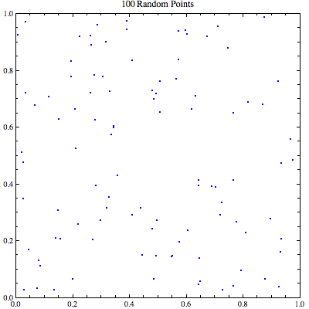
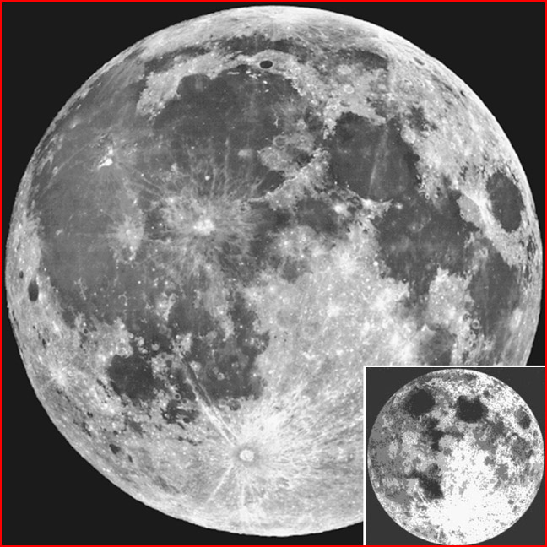
Apophenia
Cognitive biases
Spontaneous perception of connections and meaningfulness of unrelated phenomena
Figure of the man in the moon
Figure of random points representing the clustering illusion
www.thunderbolts.info

Slide 50
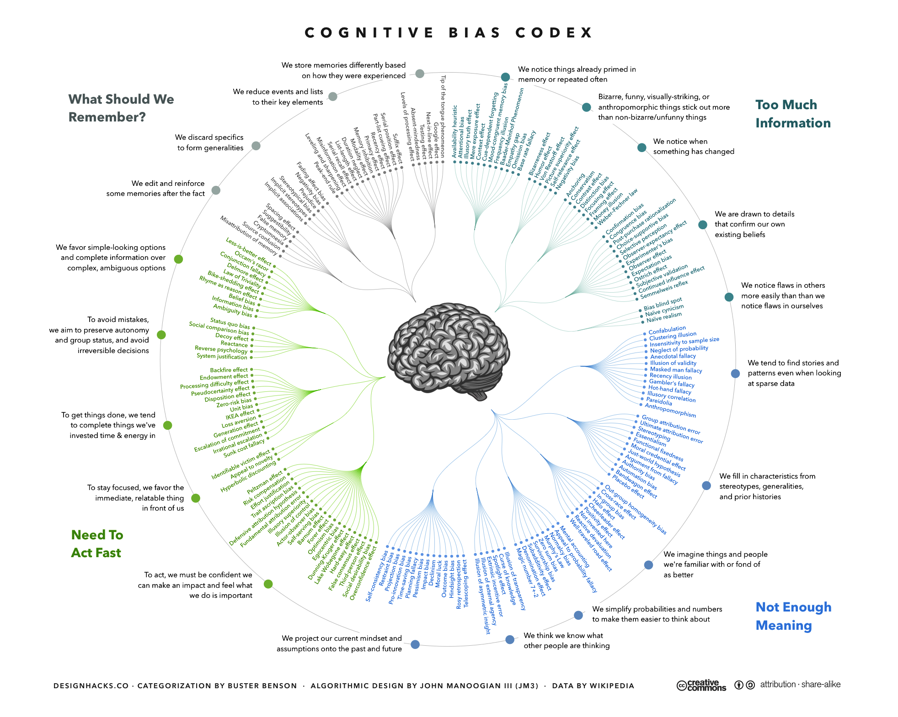
Wikipedia's complete (as of 2016) list of cognitive biases, John Manoogian

Slide 51
Debiasing techniques
Prompt for alternative hypotheses
Avoid anchors
Provide multiple and counter anchors
Ask for counterfactuals
Use multiple experts
Adopt group processes
Montibeller and Detlof von Winterfeldt. 2015. Cognitive and Motivational Biases in Decision and
Risk Analysis, Risk Analysis

Slide 52

Model development process
1-2 Café
Structured conversational process - Disaggregate and discuss
A?
a1
A
a1
?
a2
?
a4
a2
a4
b3
b3
a3
?
b2
?
a3
b2
?
b4
b4
http://www.designkit.org/
b1
b1

Slide 53
Model development process
1-2 Café
Structured conversational process - Disaggregate and discuss
-
-
-
-
-
-
-
-
-
-
-
-
-
-
-
-
~5 minutes
Each person lists their ideas on paper
-
-
-
-
-
-
-
-
~5 minutes
Create a new agreed list with neighbor
A?
a1
A
a1
?
a2
?
a4
a2
a4
b3
Share with the whole group through drawing relationships (bubbles and arrows)
~20 minutes
b3
a3
?
b2
?
a3
b2
?
b4
b4
b1
b1

Slide 54

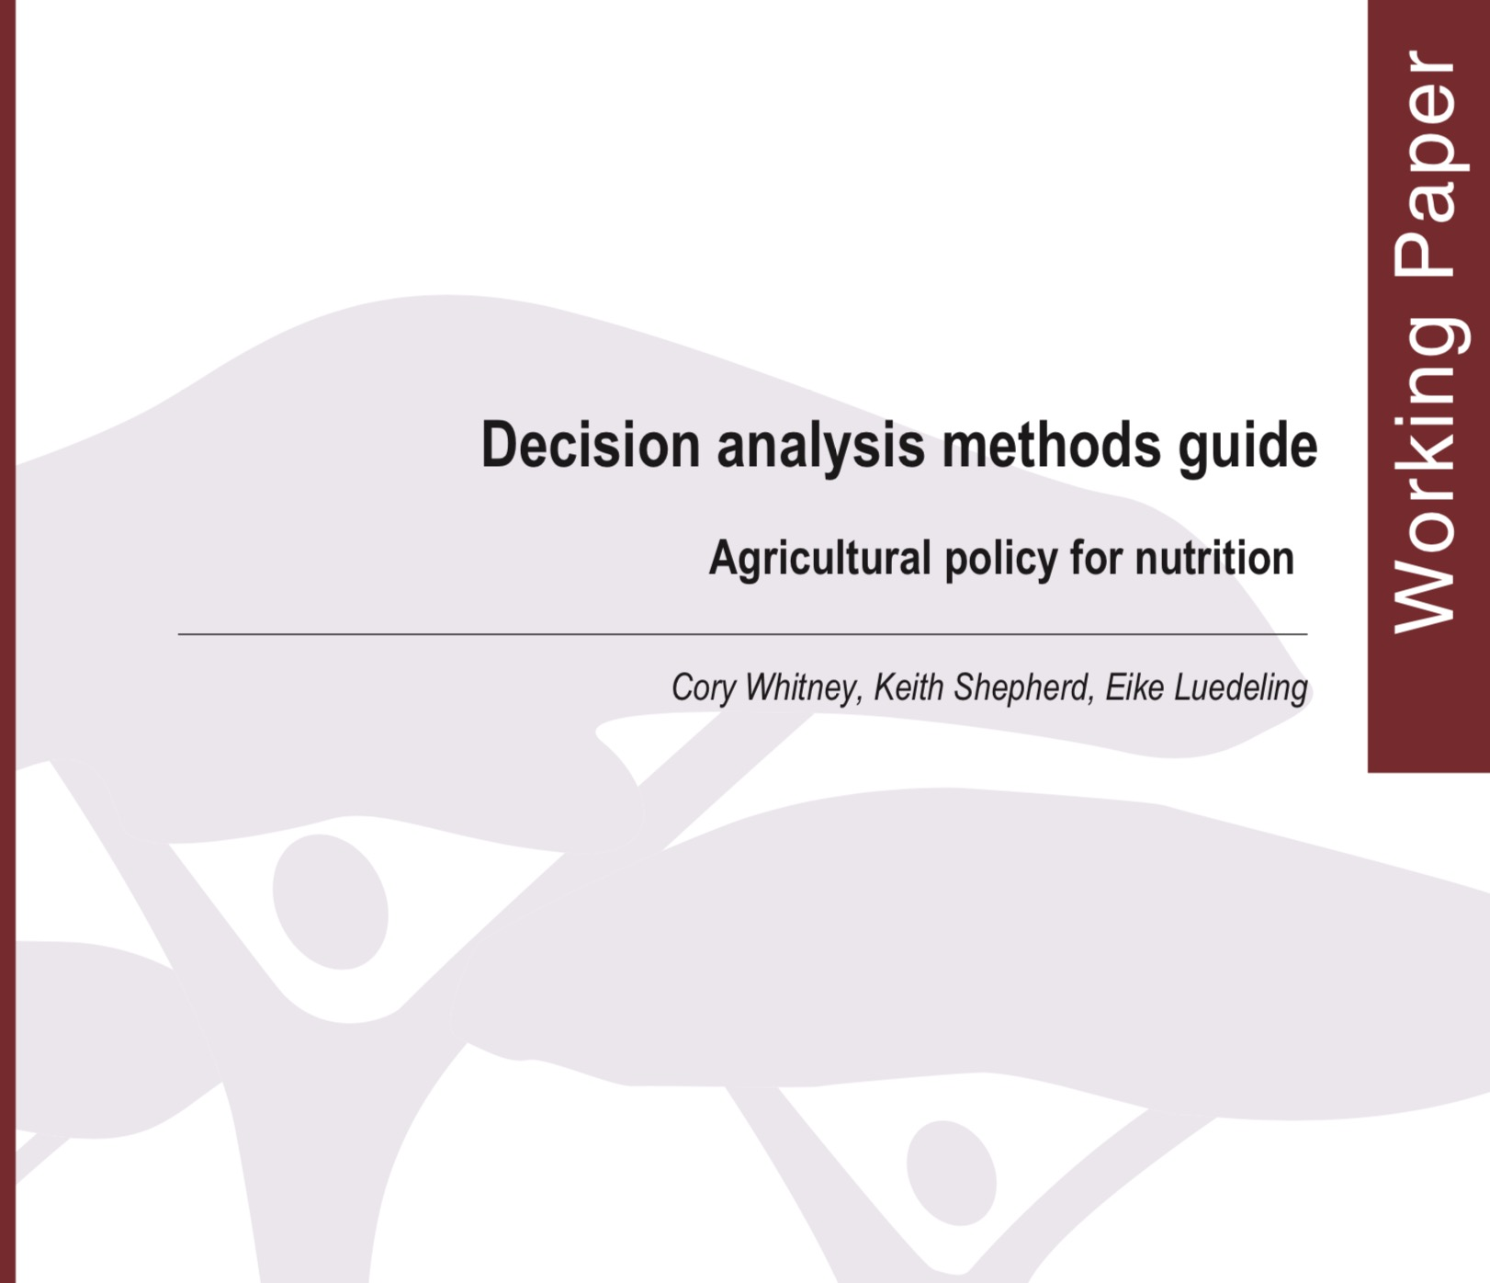
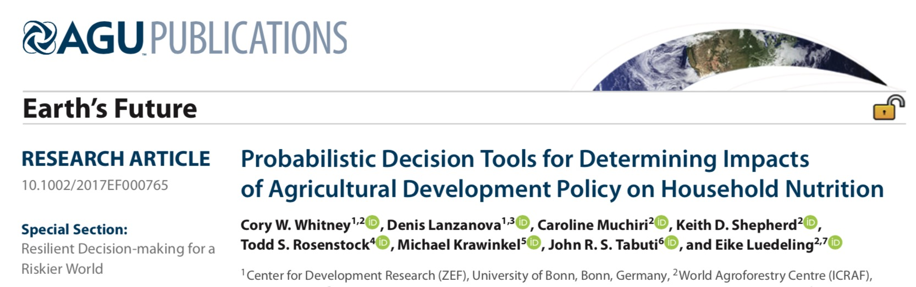
Resources for this approach
Luedeling, E., Whitney, C. (2017), Controlled burns in conifer forests. R Pubs
Whitney, C., Luedeling, (2017), Simulating the cost effectiveness of controlled burning with the decisionSupport R package.
Whitney, C., Lanzanova, D., Muchiri, C., Shepherd, K., Rosenstock, T., Krawinkel, M., Tabuti, J. R. S., and Luedeling, E. (2018). Earth’s Future
Whitney, C., Shepherd, K., and Luedeling, E., 2018.
World Agroforestry Centre, Nairobi.
Notes:
Advertisement about resources that can help you all follow up on the DA approaches Eike talked about

Slide 55
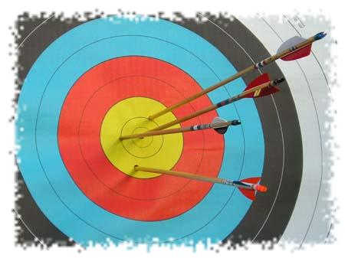
Estimating our state of knowledge
Monte Carlo allows us to shoot multiple arrows
As model inputs, we need estimates that reflect our state of uncertainty, expressed as probability distributions
Most people aren’t initially very good at estimating confidence intervals due to biases (e.g. overconfidence, anchoring)

Slide 56
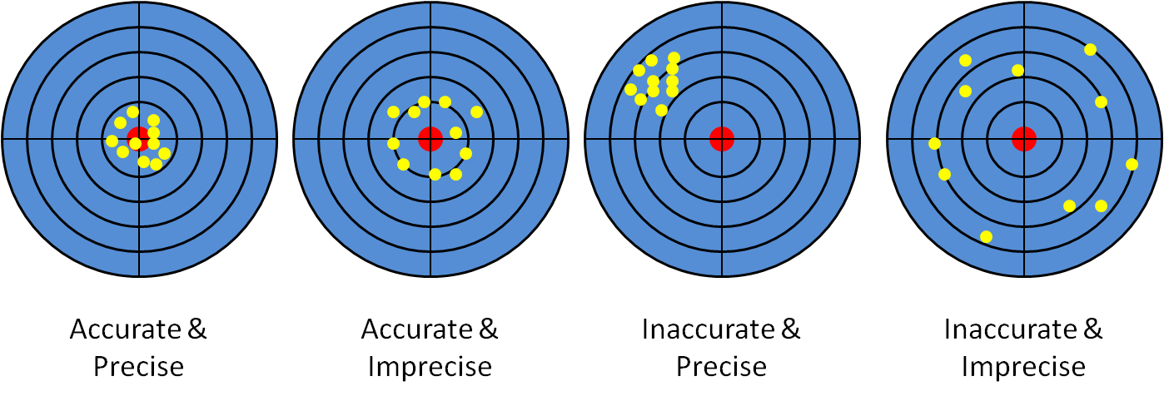
Estimating our state of knowledge
Precision vs. accuracy
Can be enough, if we really don’t know better
Unrealistic (?)
Sometimes possible
Bad
‘Calibration training’ increases awareness of bias and ability to estimate ranges
http://www.knowitsdifference.com

Slide 57
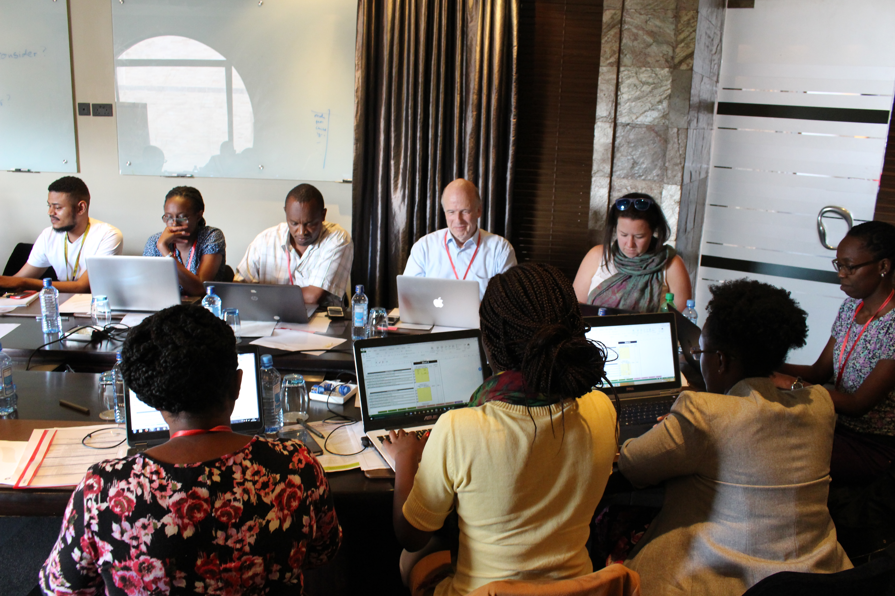
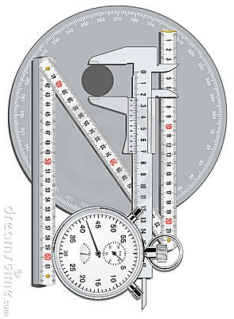
Model development process
Calibration training
Participants are calibrated to build a model
Fruit trees and nutrition in Kenya
Notes:
In the same way that you calibrate a Ph test. We give questions to which the answer is known, 90% correct when they have 90% confidence

Slide 58
Model development process
Calibration training
What is being elicited is expert, not perfect, opinions
Expert knowledge can capture information not adequately represented by observed data
Kadane, J. B., and L. J. Wolfson. 1998. Experiences in elicitation. Statistician 47:3–19.

Slide 59
Decision Analysis in Research for Agricultural Development
Approaches
Decision Analysis
Model building
Overcoming Bias
Case Studies
Conclusions

Slide 60



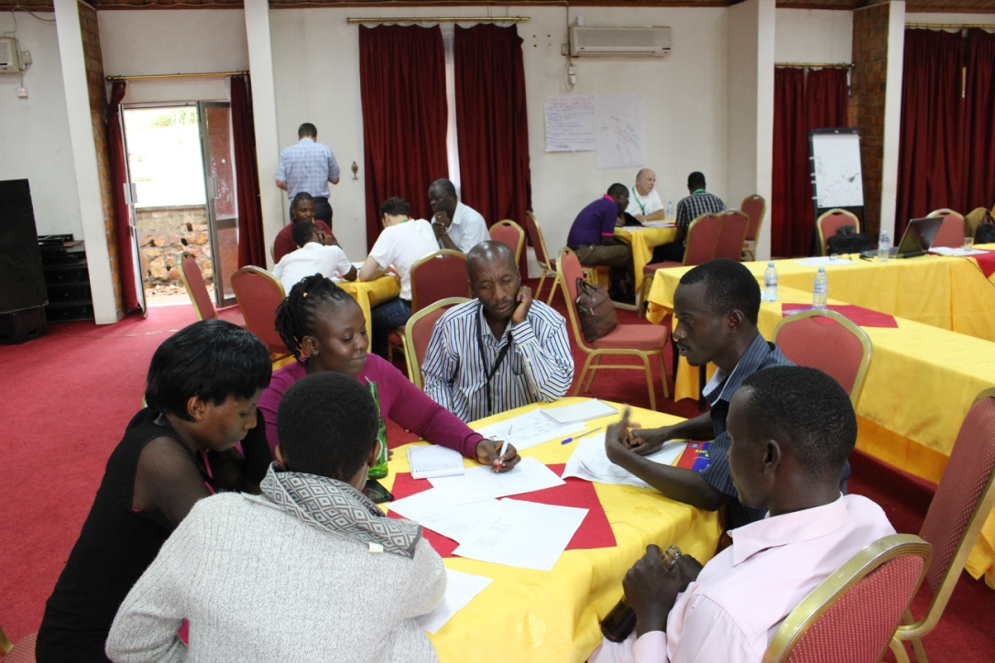








Decision Analysis case studies

Slide 61

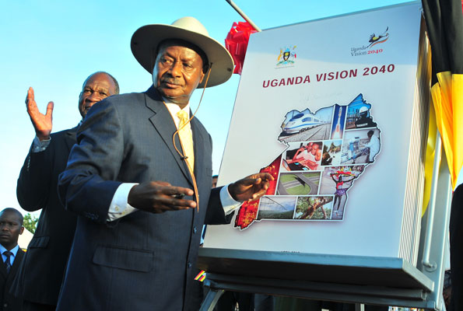

Vision 2040 agricultural industrialization
“A Transformed Ugandan Society from a Peasant to a Modern and Prosperous Country within 30 years”
President Museveni Endorses Vision 2040, Photo by Hon. Frank Tumwebaze
NPA. 2007. Uganda Vision 2040. National Planning Authority (NPA), Government of Uganda, Kampala
- 2010. National Development Plan.
- 2011. Uganda Nutrition Action Plan 2011-2016.
- 2015. National nutrition planning guidelines for Uganda.
- 2017. Towards Zero Hunger. A Strategic Review of Sustainable Development Goal 2 in Uganda.
Notes:
Cabinet approved the National Vision Statement, “A Transformed Ugandan Society from a Peasant to a Modern and Prosperous Country within 30 years”
Framework for policies that refer to agriculture
What will be the implications for human nutrition?

Slide 62
Vision 2040 agricultural industrialization
Dataset on structure and composition of homegardens in Uganda
‘Vision 2040’ document of the Ugandan government
Agricultural policies in Uganda favor large-scale staple crop production over traditional homegardens
Homegardens are complex and heterogeneous, so coherent evidence on their performance is difficult to produce
Can decision analysis thinking help demonstrate their nutritional potential?
Plausible range estimates for crop type distribution, area covered, yields, nutrient contents etc. (literature and expert estimates)
Monte Carlo simulation (10,000 runs)
Total nutrient production by homegardens
Total nutrient production by large-scale agriculture
Whitney et al., 2017. Agricultural Systems 154, 133-144.

Slide 63
Vision 2040 agricultural industrialization
Confidence in superior production for each system (%)
For each land use option, confidence that it is superior in producing nutrients
Large-scale staple crops
Homegardens
Large-scale production produces more macronutrients – homegardens more essential micronutrients
Implementation of Vision 2040 may aggravate malnutrition problems
Major knowledge gaps: future yields and nutrient contents for many crops
Whitney et al., 2017. Agricultural Systems 154, 133-144.

Slide 64





Vision 2040 agricultural industrialization
Vision 2040 aims to promote large-scale agriculture, removing ‘peasant’ homegardens
Implications for human nutrition?
Can this decision be improved?
Staples: cassava, bananas, rice, potatoes, maize
Pulses: beans
Export crops: tea, coffee
Banana
(Musa spp.)
Cassava
(Manihot esculenta)
Common bean
(Phaseolus spp.)
Ministry of Agriculture, Animal Industry and Fisheries, 2010. Agriculture Sector Development Strategy and Investment Plan: 2010/ 11–2014/15. MAAIF, Kampala, Uganda.
Notes:
implicit link between food insecurity and low agricultural production, reflected in policy
Vision 2040 calls for agricultural intensification across Uganda focused on a few crops with potential for commercialization and value addition

Slide 65


Vision 2040 agricultural industrialization
Impact pathway
Energy
Normal yield
Yield increment
Vitamins
Yields
Total farm area
Macronutrients
Nutrition
Land equivalent
Food Production area
Micronutrients
Non food area
Cooking
Postharvest losses
Nutrient losses
Whitney et al., 2017. Agricultural Systems 154, 133-144.
Notes:
Upper and lower bounds based on subjective probabilities
Test parts of the model? Outputs match reality…
Not explict, important

Slide 66
Vision 2040 agricultural industrialization
Impact pathway
Energy
Normal yield
Yield increment
Vitamins
Yields
Total farm area
Macronutrients
Nutrition
Land equivalent
Food Production area
Micronutrients
Non food area
Cooking
Postharvest losses
Nutrient losses
Whitney et al., 2017. Agricultural Systems 154, 133-144.

Slide 67



Vision 2040 agricultural industrialization
Impact pathway
0.8
Total production area (ha)
0.6
0.4
Total farm area
0.2
46 meters
Land equivalent
0
Food Production area
7
6
Non-food
production area (%)
Non food area
5
4
43 meters
3
Vision 2040
Homegardens
Whitney et al., 2017. Agricultural Systems 154, 133-144.

Slide 68

Vision 2040 agricultural industrialization
Impact pathway
10
Annual yields (tons/ha)
Normal yield
Yield increment
5
Yields
Total farm area
0
Land equivalent
Food Production area
4
Annual additional yields
From inputs (tons/ha)
2
Non food area
Vegetable
0
Staple
Spice
Whitney et al., 2017. Agricultural Systems 154, 133-144.
Pulse
Fruit

Slide 69


Vision 2040 agricultural industrialization
Impact pathway
Energy
(kcal/100g)
Energy
Normal yield
300
Yield increment
200
Vitamins
Yields
100
Total farm area
0
Macronutrients
Land equivalent
200
Vitamin A
(mcg RAE/100g)
Food Production area
Micronutrients
100
Non food area
0
Vegetable
Staple
Spice
Whitney et al., 2017. Agricultural Systems 154, 133-144.
Pulse
Fruit

Slide 70


Vision 2040 agricultural industrialization
Applied Information Economics:
Hubbard, D. W., 2014. How To Measure Anything: Finding the Value of Intangibles in Business. John Wiley & Sons, Hoboken, New Jersey.
Own research:
Whitney, C. W., E. Luedeling, J. R. S. Tabuti, A. Nyamukuru, O. Hensel, J. Gebauer, and K. Kehlenbeck, 2018. Agriculture and Human Values, 35 (2), 399-424.
…
x1
Databases:
FAO, 2014. FAO GEOnetwork . www.fao.org/geonetwork
FAPDA, 2015. Uganda Country Fact Sheet on Food and Agriculture Policy Trends. Food and Agriculture Policy Decision Analysis (FAPDA), Rome.
…
x2
Model
function
Output
distribution
x3
National Planning Authority (NPA), Government of Uganda:
2007. Uganda Vision 2040.
2010. National Development Plan.
2011. Uganda Nutrition Action Plan 2011-2016.
2015. National nutrition planning guidelines for Uganda.
…
x4
x5
Implemented with the decisionSupport R package
Luedeling, E., and Goehring, L., 2017. R programming language. Version1.103.7.

Slide 71
Vision 2040 agricultural industrialization
welfareDecisionAnalysis()
decisionSupport()
make_CPT()
Model
function
VIP()
Output
distribution
individualEvpiSimulation()
plsr.mcSimulation()
gompertz_yield()
Implemented with the decisionSupport R package
Luedeling, E., and Goehring, L., 2017. R programming language. Version1.103.7.

Slide 72


Vision 2040 agricultural industrialization
Model outcome distributions
Estimated Average Requirement.
National Academies of Science, 2016. Interactive DRI for Healthcare Professionals. National Academies of Science, Food and Nutrition Information Center.
https://fnic. nal.usda.gov/fnic/interactiveDRI/
Micrograms Retinol Activity Equivalents
Output
distribution
% confidence in superior production in each system
Vision 2040
Homegardens
Notes:
Monthly nutrient contributions in 10,000 Monte Carlo model runs
Grey lines across graph AS REFRENCE ONLY minimum Estimated Average Requirement for a household of 4.7 adults and 2.3 children.

Slide 73





Vision 2040 agricultural industrialization
Information value
“The cost of being wrong times the chance of being wrong”
Key knowledge gaps
Output
distribution
No knowledge gap identified
Vision 2040
Homegardens
Hubbard, D. W., 2014. How To Measure Anything: Finding the Value of Intangibles in Business. John Wiley & Sons, Hoboken, New Jersey.
Notes:
EVPI
Maximum willing to pay for additional information.

Slide 74
Vision 2040 agricultural industrialization
All uncertain quantities estimated as plausible ranges
Large uncertainties but answer still clear for most nutrients
Output
distribution
Vision 2040
Homegardens
Vision 2040 likely to reduce production of many ‘hidden hunger’ nutrients
Notes:
None of 10,000 model runs produced a scenario where Vision 2040 farms out produced HGs in Vitamin C

Slide 75
Modeling the benefits of fruit trees in agricultural landscapes of Kenya
Kenya seeks better nutrition outcomes from agriculture as outlined in the Vision 2030, Constitution and resulting policies:
Agricultural Sector Development Strategy (ASDS), National Food Security and Nutrition Policy (NFSNP) and National Agricultural Sector Extension Policy (NASEP)
Planting more fruit trees could improve nutrition in Kenya, especially for rural farming families
There is a lack of scientific support to anticipate specific policy outcomes
?
?
?
?
?
?
?
?
?
?
?
Agricultural development decision
Production & consumption of healthy food
?
Nutrition outcomes
Production
?
Nutrient gap
?
?
?
?
?
?
?
?
?
Luedeling, E. and Whitney, C. (2018) Harvard Dataverse
Whitney, C. W., Shepherd, K. D., Krawinkel, M. and E, L. (2018) ICRAF Policy Brief 40, 4
Whitney, C., Shepherd, K., Krawinkel, M., Lanzanova, D. and Luedeling, E. (2018) Tropentag Ghent 364

Slide 76

Collaborative decision model design process. Performed in a workshop.
Individuals
Consider question on own
Divide working groups among questions
Consider question with neighbor
Final graphical model
Decision broken down into specific questions
Share insights with working group
Repeat for each question
Create graphical representation of ideas
Decision and scope defined
Experts and analysts worked together to collaboratively build a model and create forecasts for the potential impacts of fruit trees on smallholder farms in Kenya.
Plenary
Working groups

Slide 77
Comparison of farming households in Kenya with varieties of mango (Mangifera indica L.) and avocado (Persea americana Mill.) trees to those without.
Production
Genetic
Water
Yield
Temperature
Soil
Pest and disease
Dietary intake
Nutrient gap
Quality
Fruit
Energy
Effectiveness
Iron
Off-farm
Knowledge
Vitamin A
Other on-farm
Skill
Zinc
Food preferences
Model of production, management and household composition factors influencing household dietary intake and consequent nutrient gaps in energy, iron, provitamin A and zinc.
Management
Experts were trained to assess their uncertainty and overcome biases to provide accurate model estimates
Nutrient needs
Labor
Household
Luedeling, E. and Whitney, C. (2018) Harvard Dataverse
Whitney, C. W., Shepherd, K. D., Krawinkel, M. and E, L. (2018) ICRAF Policy Brief 40, 4
Whitney, C., Shepherd, K., Krawinkel, M., Lanzanova, D. and Luedeling, E. (2018) Tropentag Ghent 364

Slide 78
‘Parent’ and ‘Child’ nodes with Conditional Probabilities of various states of both defined in tables.
Whitney, C., Shepherd, K., and Luedeling, E., 2018. World Agroforestry Centre, Nairobi.

Slide 79






Key findings from model results
Fruit trees can provide many benefits and contribute to Kenya’s national nutrition goals
Various interacting factors influence fruit tree planting and subsequent nutrition outcomes for farmer households in Kenya
Decision analysis can provide appropriate support for understanding the probable outcomes of nutrition-related policy decisions
Energy (kcal)
Nutrient gap
-500,000
1,000,000
Trees
No trees
Iron (mg)
-6,000
10,000
Vitamin A
(Retinol Activity Equivalents)
-400,000
1,000,000
Zinc (mg)
-1,000
4,000
Estimated annual nutritional needs
Luedeling, E. and Whitney, C. (2018) Harvard Dataverse
Whitney, C. W., Shepherd, K. D., Krawinkel, M. and E, L. (2018) ICRAF Policy Brief 40, 4
Whitney, C., Shepherd, K., Krawinkel, M., Lanzanova, D. and Luedeling, E. (2018) Tropentag Ghent 364
Sufficient diet
Insufficient diet

Slide 80
Resources for this approach
cory.whitney@uni-bonn.de
Luedeling, E., Whitney, C. (2017), Controlled burns in conifer forests. R Pubs
Whitney, C., Luedeling, (2017), Simulating the cost effectiveness of controlled burning with the decisionSupport R package.
Whitney, C., Lanzanova, D., Muchiri, C., Shepherd, K., Rosenstock, T., Krawinkel, M., Tabuti, J. R. S., and Luedeling, E. (2018). Earth’s Future
Whitney, C., Shepherd, K., and Luedeling, E., 2018.
World Agroforestry Centre, Nairobi.
Notes:
Advertisement about resources that can help you all follow up on the DA approaches Eike talked about

Slide 81
Decision Analysis in Research for Agricultural Development
Approaches
Decision Analysis
Model building
Overcoming Bias
Case Studies
Conclusions

Slide 82
Conclusions
Decision sciences offer a fitting paradigm for agricultural modeling
?
Decision sciences are geared towards solving problems
They don’t aim at precision or ultimate answers, but at offering comprehensive advice for decisions and system management
If solving problems, supporting decisions and facilitating development in complex systems is our goal we should adopt decision analysis thinking as our research paradigm
?
?
Agricultural development decision
?
Outputs
?
Outcomes
?
42
Luedeling et al. 2017, Tropentag Bonn, Cuvillier Verlag, 248.

Slide 83
cory.whitney@uni-bonn.de
Even without a concrete decision context, a probabilistic approach can improve many studies.
Think about what this can do for your research.

